Slide 1
UB – 3 Regression and Forecasting Models Analysis
Flavio Bartmann
Spring 2022

Slide 2
Simple Linear Regression
Simple linear regression models are used to summarize and study relationships between two continuous (quantitative) variables in a variety of situations.
We will first state the basic questions we would like to address, the fundamental concepts and basic procedures of simple linear regression.
We will also learn two measures that describe the strength of the linear association that we find in data.

Slide 3
Linear Dependence
Now consider the graph below. It is clear that the values taken by y are not independent of the values in the horizontal axis. Larger values of y occur to the right of the graph indicating that we can predict better the values now than in the context of the previous graph. Clearly, the knowledge of the value of the Index variable would be useful in guessing (predicting) the value of y.
The relationship however is not deterministic. Knowledge of the Index value is not, by itself, enough to guess exactly what the value of y will be: there seems to be some random component in y that is not related to the Index.

Slide 4
Statistical Models
The relationships we will be considering are statistical. In many contexts, relationships are deterministic. In electricity V=R.I, i.e, if one knows the voltage and the resistance one would know, exactly, the current. Looking at the graph below, one would accept that students with higher GPAs in high school tend to have higher GPAs in college, but knowledge of the high school GPA will only give an approximate idea of where the college GPA will be.

Slide 5
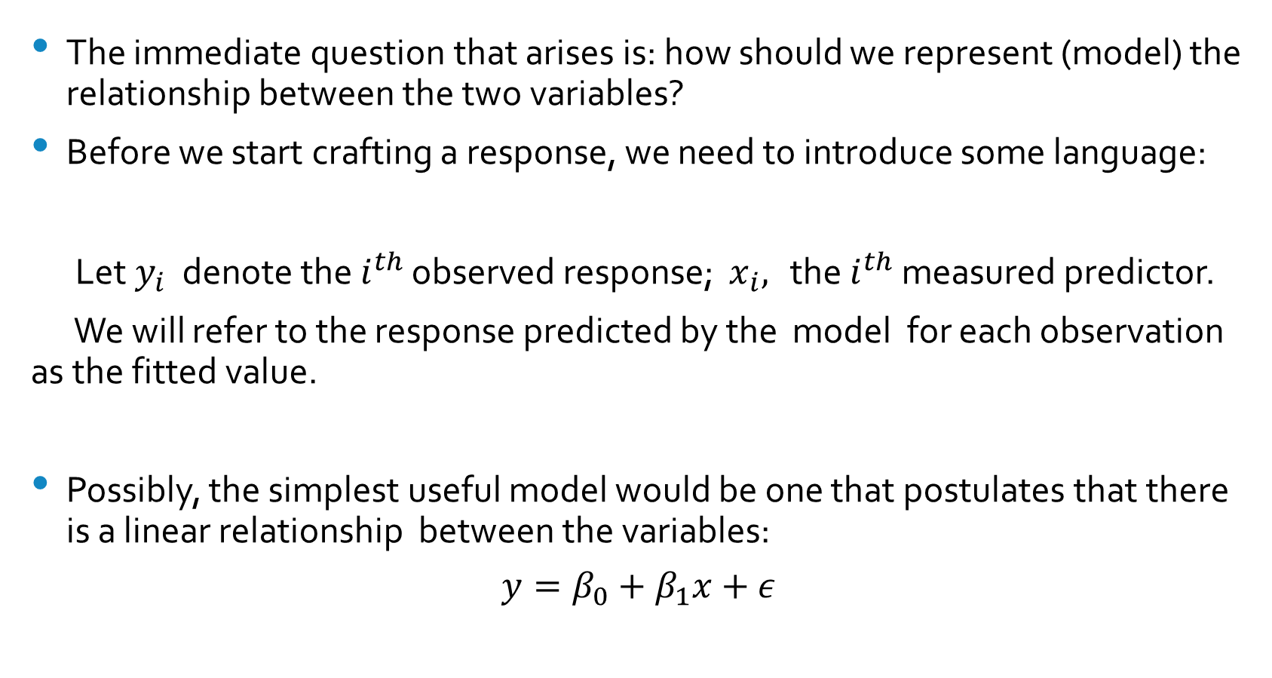
Basic Questions
The immediate question that arises is: how should we represent (model) the relationship between the two variables?
Before we start crafting a response, we need to introduce some language:
Let $y_{i}$ denote the $i^{th}$ observed response; $x_{i},$ the $i^{th}$ measured predictor.
We will refer to the response predicted by the model for each observation as the fitted value.
Possibly, the simplest useful model would be one that postulates that there is a linear relationship between the variables:
$$y=β_{0}+β_{1}x+ε$$

Slide 6
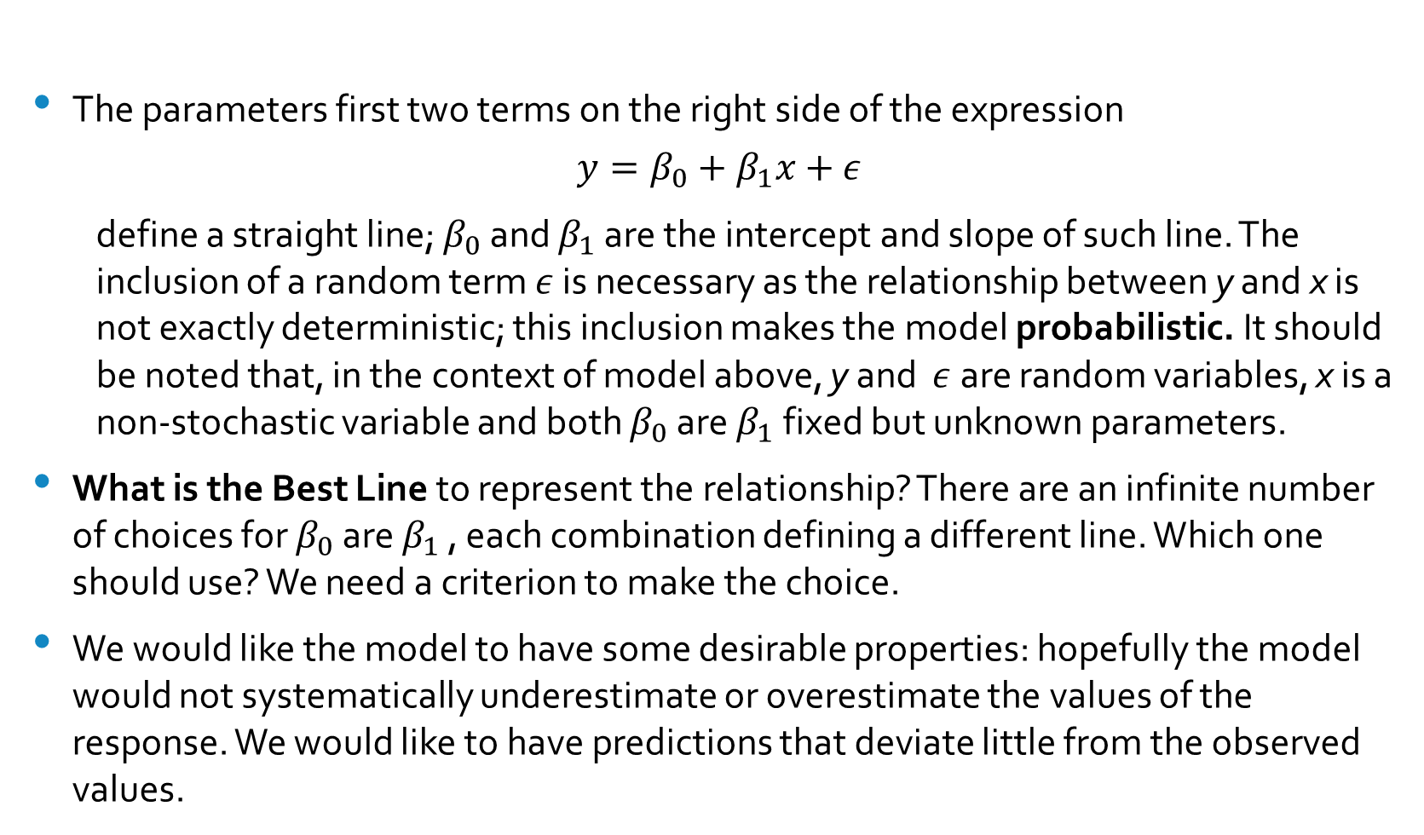
The Simple Linear Regression Model
The parameters first two terms on the right side of the expression
$$y=β_{0}+β_{1}x+ε$$
define a straight line; $β_{0}$ and $β_{1}$ are the intercept and slope of such line. The inclusion of a random term $ε$ is necessary as the relationship between y and x is not exactly deterministic; this inclusion makes the model probabilistic. It should be noted that, in the context of model above, y and $ε$ are random variables, x is a non-stochastic variable and both $β_{0}$ are $β_{1}$fixed but unknown parameters.
What is the Best Line to represent the relationship? There are an infinite number of choices for $β_{0}$ are $β_{1}$ , each combination defining a different line. Which one should use? We need a criterion to make the choice.
We would like the model to have some desirable properties: hopefully the model would not systematically underestimate or overestimate the values of the response. We would like to have predictions that deviate little from the observed values.

Slide 7
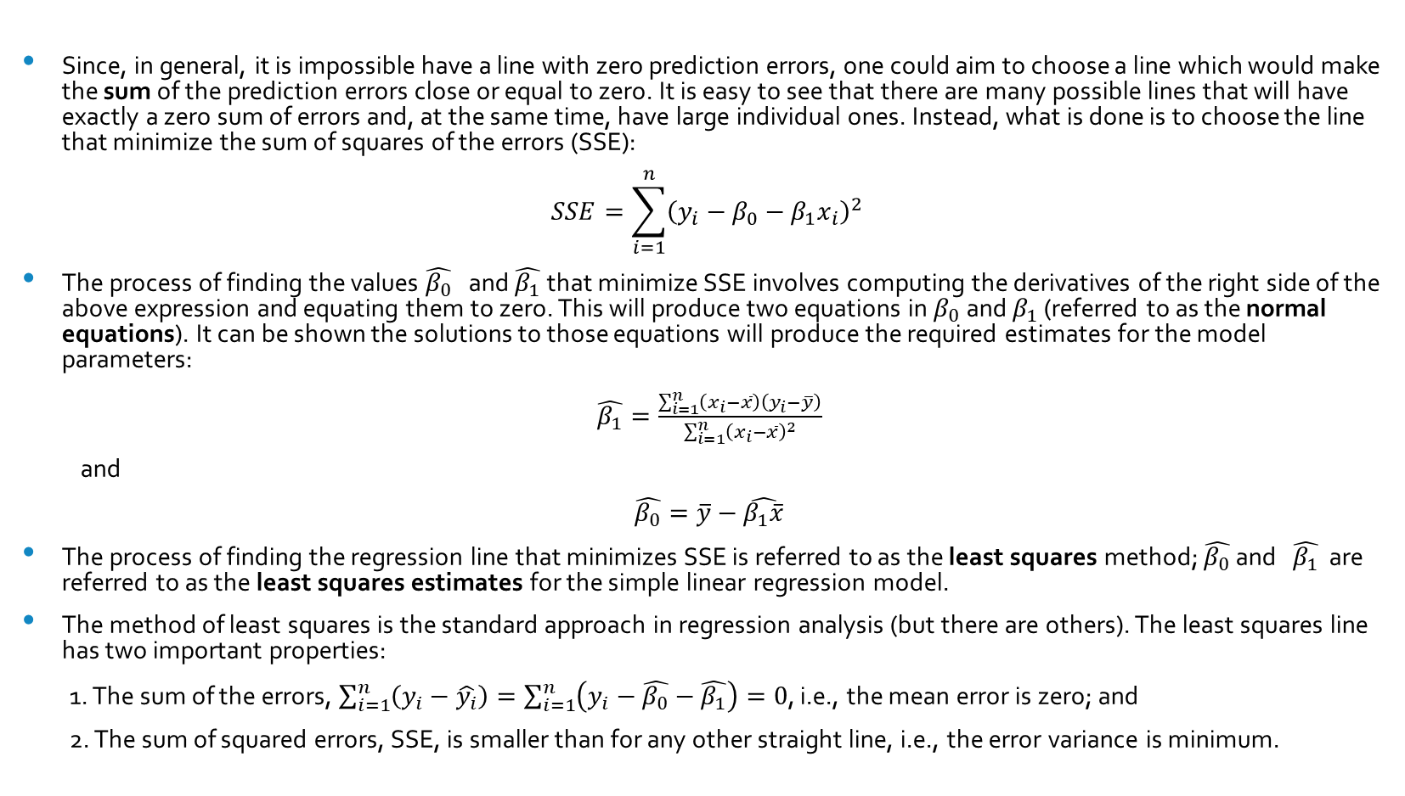
The Least Squares Method
Since, in general, it is impossible have a line with zero prediction errors, one could aim to choose a line which would make the sum of the prediction errors close or equal to zero. It is easy to see that there are many possible lines that will have exactly a zero sum of errors and, at the same time, have large individual ones. Instead, what is done is to choose the line that minimize the sum of squares of the errors (SSE):
$$SSE=\sum_{i=1}^{n}{{\left(y_{i}−β_{0}−β_{1}x_{i}\right)}^{2}}$$
The process of finding the values $\hat{β_{0}}$ and $\hat{β_{1}}$ that minimize SSE involves computing the derivatives of the right side of the above expression and equating them to zero. This will produce two equations in $β_{0}$ and $β_{1}$ (referred to as the normal equations). It can be shown the solutions to those equations will produce the required estimates for the model parameters:
$\hat{β_{1}}=\frac{\sum_{i=1}^{n}{\left(x_{i}−\overline{x}\right)\left(y_{i}−\overline{y}\right)}}{\sum_{i=1}^{n}{{\left(x_{i}−\overline{x}\right)}^{2}}}$
and
$\hat{β_{0}}=\overline{y}−\hat{β_{1}\overline{x}}$
The process of finding the regression line that minimizes SSE is referred to as the least squares method; $\hat{β_{0}}$ and $\hat{β_{1}}$ are referred to as the least squares estimates for the simple linear regression model.
The method of least squares is the standard approach in regression analysis (but there are others). The least squares line has two important properties:
1. The sum of the errors, $\sum_{i=1}^{n}{\left(y_{i}−\hat{y_{i}}\right)}=\sum_{i=1}^{n}{\left(y_{i}−\hat{β_{0}}−\hat{β_{1}}\right)}=0$, i.e., the mean error is zero; and
2. The sum of squared errors, SSE, is smaller than for any other straight line, i.e., the error variance is minimum.

Slide 8
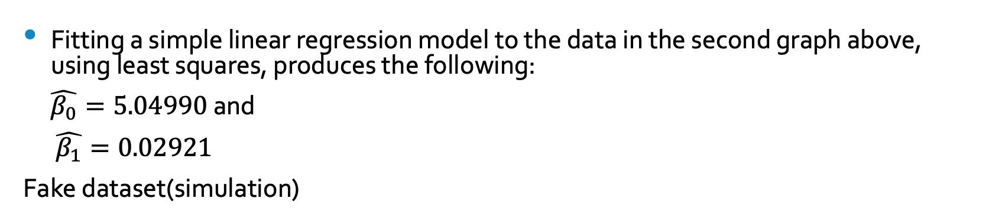
Example
Fitting a simple linear regression model to the data in the second graph above, using least squares, produces the following:
$\hat{β_{0}}=5.04990$ and
$\hat{β_{1}}=0.02921$
Fake dataset(simulation)

Slide 9
Analysis of Residuals
A very useful plot is that of the residuals vis-à-vis the fitted values:
Evidence that the dataset is simulated( residuals too ideal)

Slide 10
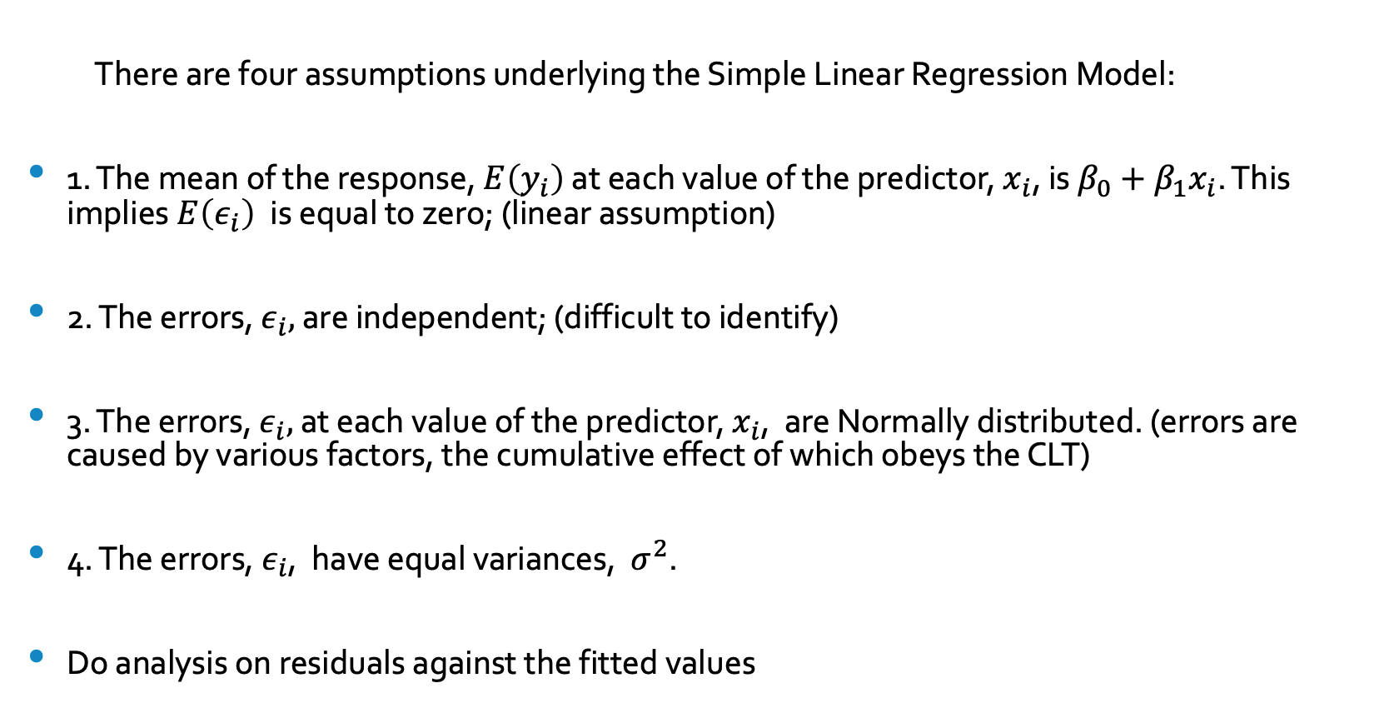
Model Assumptions
There are four assumptions underlying the Simple Linear Regression Model:
1. The mean of the response, $E\left(y_{i}\right)$ at each value of the predictor, $x_{i}$, is $β_{0}+β_{1}x_{i}$. This implies $E\left(ε_{i}\right)$ is equal to zero; (linear assumption)
2. The errors, $ε_{i},$ are independent; (difficult to identify)
3. The errors, $ε_{i},$ at each value of the predictor, $x_{i}$, are Normally distributed. (errors are caused by various factors, the cumulative effect of which obeys the CLT)
4. The errors, $ε_{i}$, have equal variances, $σ^{2}$.
Do analysis on residuals against the fitted values

Slide 11
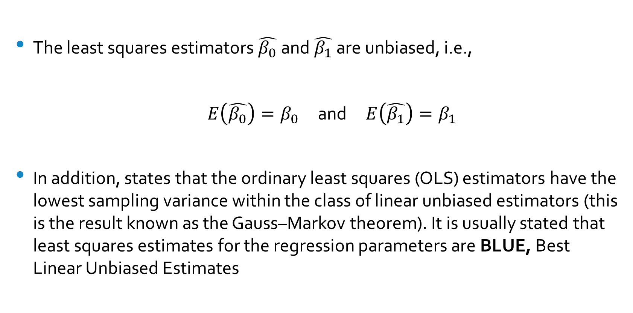
Properties of the estimators $\hat{β_{0}}$and $\hat{β_{1}}$
The least squares estimators $\hat{β_{0}}$and $\hat{β_{1}}$ are unbiased, i.e.,
$E\left(\hat{β_{0}}\right)=β_{0}$ and $E\left(\hat{β_{1}}\right)=β_{1}$
In addition, states that the ordinary least squares (OLS) estimators have the lowest sampling variance within the class of linear unbiased estimators (this is the result known as the Gauss–Markov theorem). It is usually stated that least squares estimates for the regression parameters are BLUE, Best Linear Unbiased Estimates

Slide 12
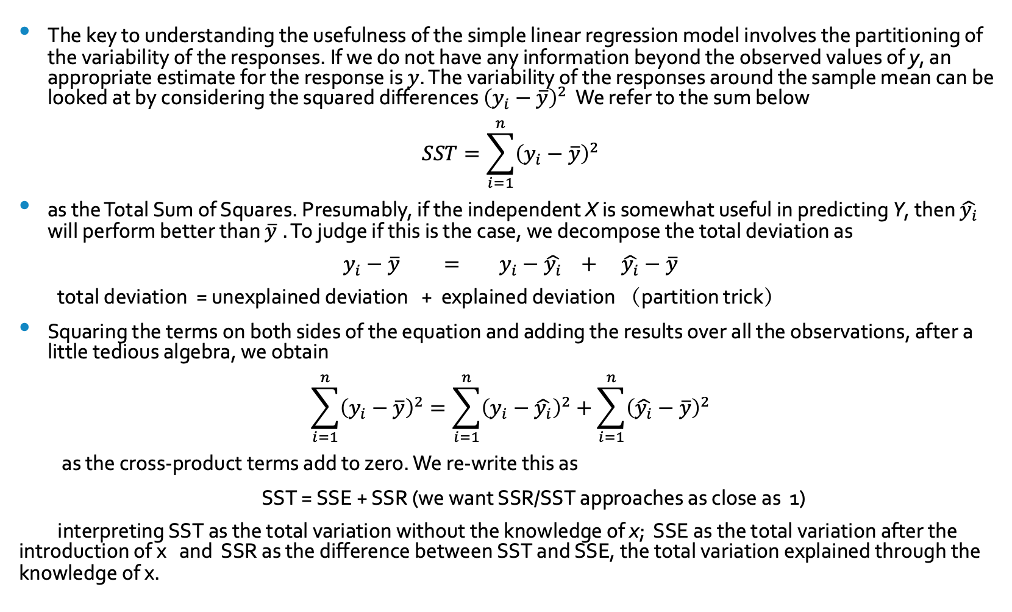
Is the Model Useful?
The key to understanding the usefulness of the simple linear regression model involves the partitioning of the variability of the responses. If we do not have any information beyond the observed values of y, an appropriate estimate for the response is $y$. The variability of the responses around the sample mean can be looked at by considering the squared differences ${\left(y_{i}−\overline{y}\right)}^{2}$ We refer to the sum below
$$SST=\sum_{i=1}^{n}{{\left(y_{i}−\overline{y}\right)}^{2}}$$
as the Total Sum of Squares. Presumably, if the independent X is somewhat useful in predicting Y, then $\hat{y_{i}}$ will perform better than $\overline{y}$. To judge if this is the case, we decompose the total deviation as
$y_{i}−\overline{y} = y_{i}−\hat{y_{i}} + \hat{y_{i}}−\overline{y}$
total deviation = unexplained deviation + explained deviation （partition trick）
Squaring the terms on both sides of the equation and adding the results over all the observations, after a little tedious algebra, we obtain
$$\sum_{i=1}^{n}{{\left(y_{i}−\overline{y}\right)}^{2}}=\sum_{i=1}^{n}{{\left(y_{i}−\hat{y_{i}}\right)}^{2}}+\sum_{i=1}^{n}{{\left(\hat{y_{i}}−\overline{y}\right)}^{2}}$$
as the cross-product terms add to zero. We re-write this as
SST = SSE + SSR (we want SSR/SST approaches as close as 1)
interpreting SST as the total variation without the knowledge of x; SSE as the total variation after the introduction of x and SSR as the difference between SST and SSE, the total variation explained through the knowledge of x.

Slide 13
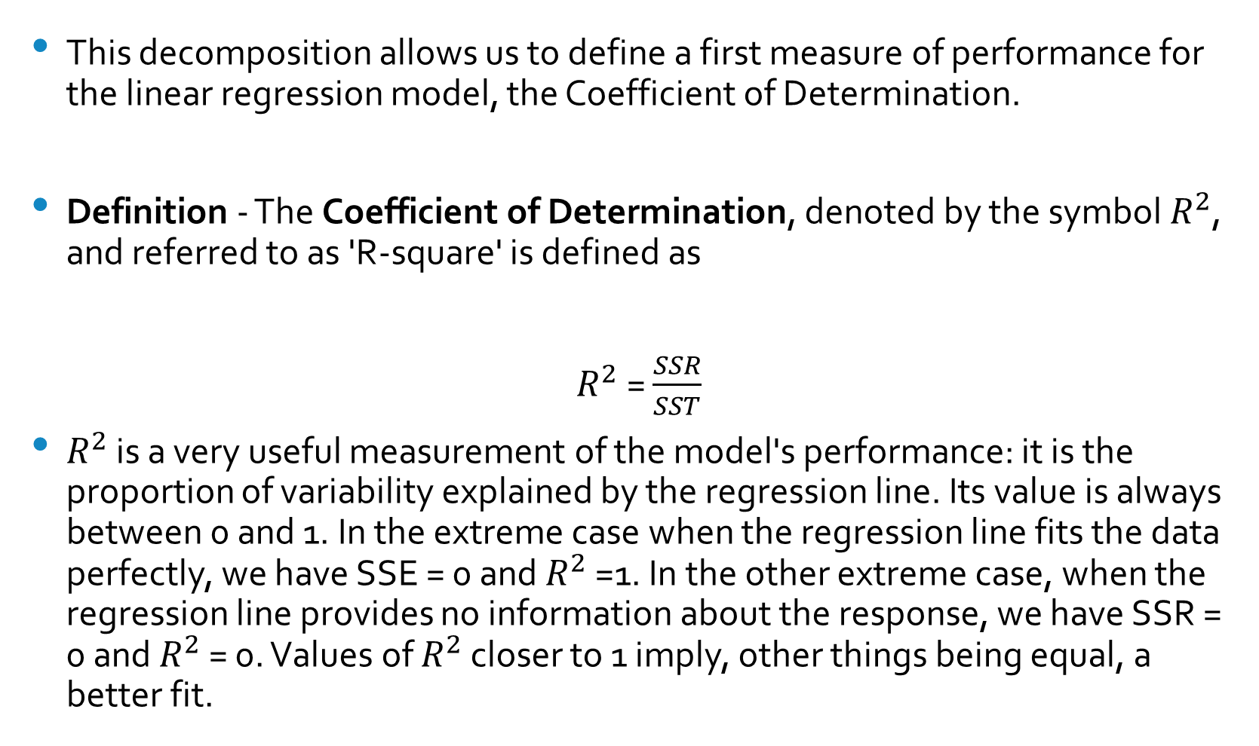
Coefficient of Determination
This decomposition allows us to define a first measure of performance for the linear regression model, the Coefficient of Determination.
Definition - The Coefficient of Determination, denoted by the symbol $R^{2}$, and referred to as 'R-square' is defined as
$R^{2}$= $\frac{SSR}{SST}$
$R^{2}$ is a very useful measurement of the model's performance: it is the proportion of variability explained by the regression line. Its value is always between 0 and 1. In the extreme case when the regression line fits the data perfectly, we have SSE = 0 and $R^{2}$ =1. In the other extreme case, when the regression line provides no information about the response, we have SSR = 0 and $R^{2}$ = 0. Values of $R^{2}$ closer to 1 imply, other things being equal, a better fit.
Analysis of Variance

Slide 14
Analysis of Variance
The calculations above permit us to compile a summary account of the variability of the responses, usually referred to as the Analysis of Variance or ANOVA table:
ANOVA Table
Source Sum of Squares df Mean Square
Regression SST 1 Regression MS
Error SSE n-2 MSE
Total SST n-1

Slide 15
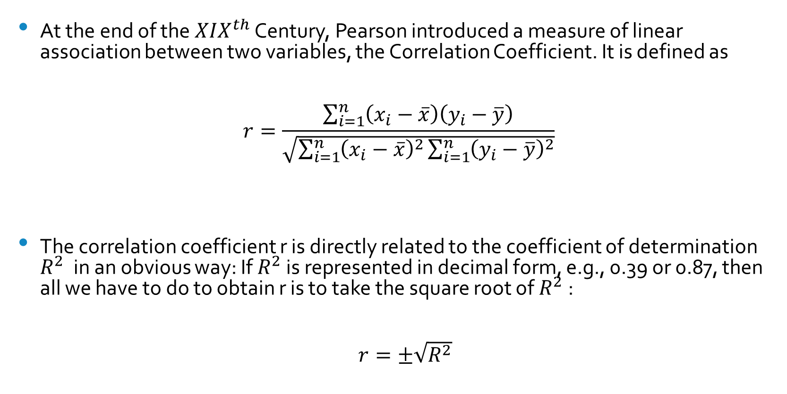
The Correlation Coefficient
At the end of the $XIX^{th}$ Century, Pearson introduced a measure of linear association between two variables, the Correlation Coefficient. It is defined as
$$r=\frac{\sum_{i=1}^{n}{\left(x_{i}−\overline{x}\right)\left(y_{i}−\overline{y}\right)}}{\sqrt{\sum_{i=1}^{n}{{\left(x_{i}−\overline{x}\right)}^{2}\sum_{i=1}^{n}{{\left(y_{i}−\overline{y}\right)}^{2}}}}}$$
The correlation coefficient r is directly related to the coefficient of determination $R^{2}$ in an obvious way: If $R^{2}$ is represented in decimal form, e.g., 0.39 or 0.87, then all we have to do to obtain r is to take the square root of $R^{2}$:
$r=±\sqrt{R^{2}}$

Slide 16
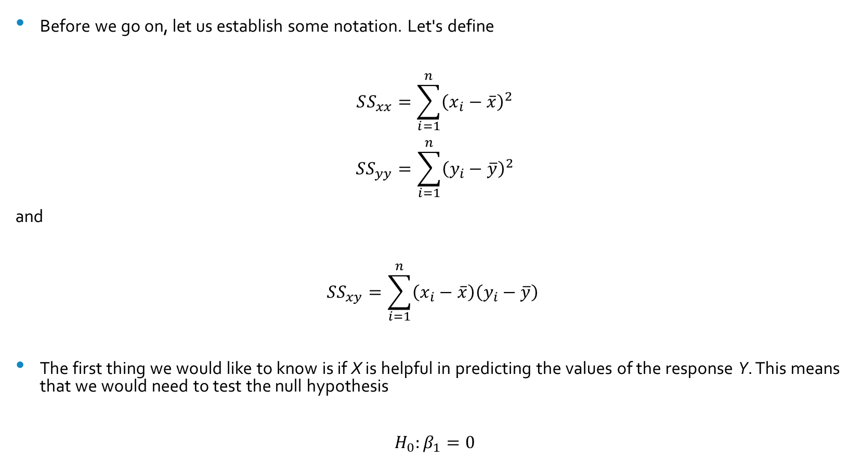
Inferences about $β_{1}$
Before we go on, let us establish some notation. Let's define
$$SS_{xx}=\sum_{i=1}^{n}{{\left(x_{i}−\overline{x}\right)}^{2}}$$
$$SS_{yy}=\sum_{i=1}^{n}{{\left(y_{i}−\overline{y}\right)}^{2}}$$
and
$$SS_{xy}=\sum_{i=1}^{n}{\left(x_{i}−\overline{x}\right)\left(y_{i}−\overline{y}\right)}$$
The first thing we would like to know is if X is helpful in predicting the values of the response Y. This means that we would need to test the null hypothesis
$$H_{0}:β_{1}=0$$

Slide 17
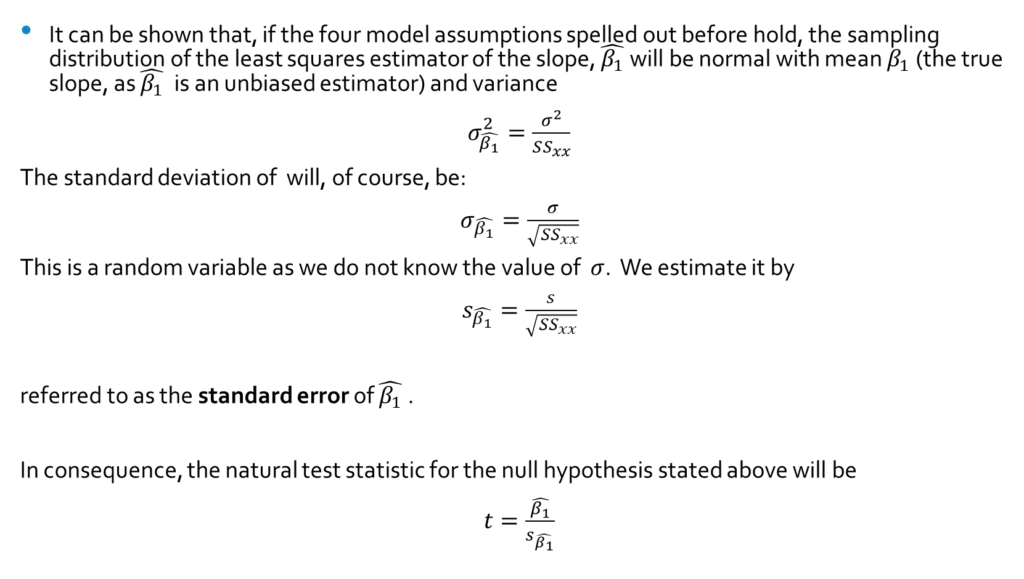
The Test Statistic
It can be shown that, if the four model assumptions spelled out before hold, the sampling distribution of the least squares estimator of the slope, $\hat{β_{1}}$will be normal with mean $β_{1}$ (the true slope, as $\hat{β_{1}}$ is an unbiased estimator) and variance
$σ_{\hat{β_{1}}}^{2}=\frac{σ^{2}}{SS_{xx}}$
The standard deviation of will, of course, be:
$σ_{\hat{β_{1}}}=\frac{σ}{\sqrt{SS_{xx}}}$
This is a random variable as we do not know the value of $σ$. We estimate it by
$s_{\hat{β_{1}}}=\frac{s}{\sqrt{SS_{xx}}}$
referred to as the standard error of $\hat{β_{1}}$ .
In consequence, the natural test statistic for the null hypothesis stated above will be
$t=\frac{\hat{β_{1}}}{s_{\hat{β_{1}}}}$

Slide 18
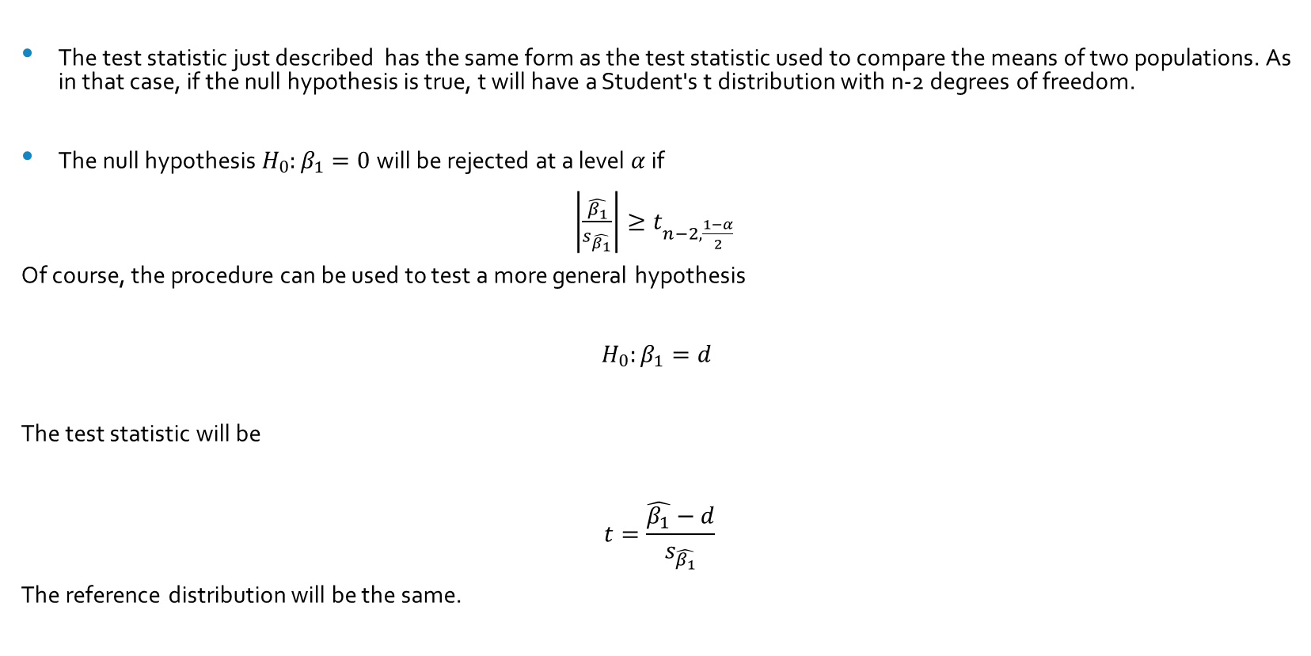
The Reference Distribution
The test statistic just described has the same form as the test statistic used to compare the means of two populations. As in that case, if the null hypothesis is true, t will have a Student's t distribution with n-2 degrees of freedom.
The null hypothesis $H_{0}:β_{1}=0$will be rejected at a level $α$if
$\left|\frac{\hat{β_{1}}}{s_{\hat{β_{1}}}}\right|≥t_{n−2,\frac{1−α}{2}}$
Of course, the procedure can be used to test a more general hypothesis
$$H_{0}:β_{1}=d$$
The test statistic will be
$$t=\frac{\hat{β_{1}}−d}{s_{\hat{β_{1}}}}$$
The reference distribution will be the same.

Slide 19
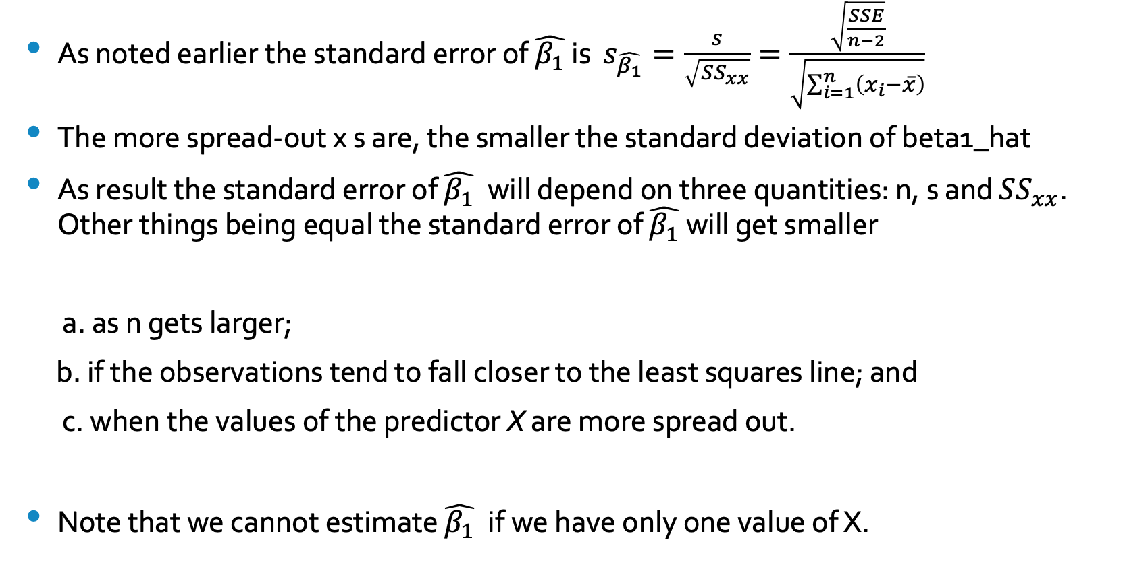
The Standard Error of $\hat{β_{1}}$
As noted earlier the standard error of $\hat{β_{1}}$ is $s_{\hat{β_{1}}}=\frac{s}{\sqrt{SS_{xx}}}=\frac{\sqrt{\frac{SSE}{n−2}}}{\sqrt{\sum_{i=1}^{n}{\left(x_{i}−\overline{x}\right)}}}$
The more spread-out x s are, the smaller the standard deviation of beta1_hat
As result the standard error of $\hat{β_{1}}$ will depend on three quantities: n, s and $SS_{xx}$. Other things being equal the standard error of $\hat{β_{1}}$ will get smaller
a. as n gets larger;
b. if the observations tend to fall closer to the least squares line; and
c. when the values of the predictor X are more spread out.
Note that we cannot estimate $\hat{β_{1}}$ if we have only one value of X.

Slide 20
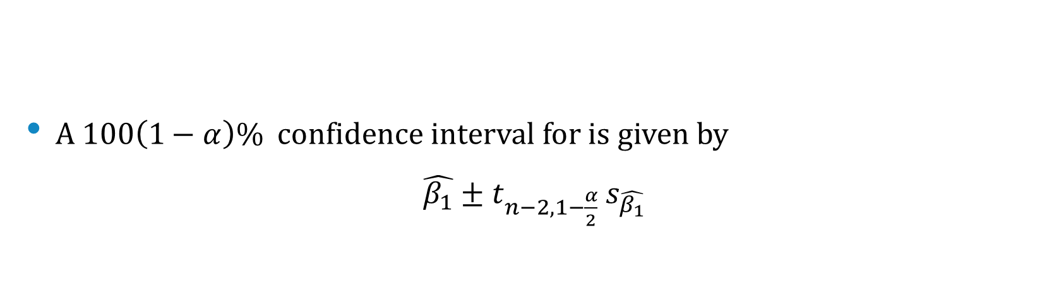
Confidence Intervals for $β_{1}$
A $100\left(1−α\right)\%$ confidence interval for is given by
$\hat{β_{1}}±t_{n−2,1−\frac{α}{2}}$ $s_{\hat{β_{1}}}$

Slide 21
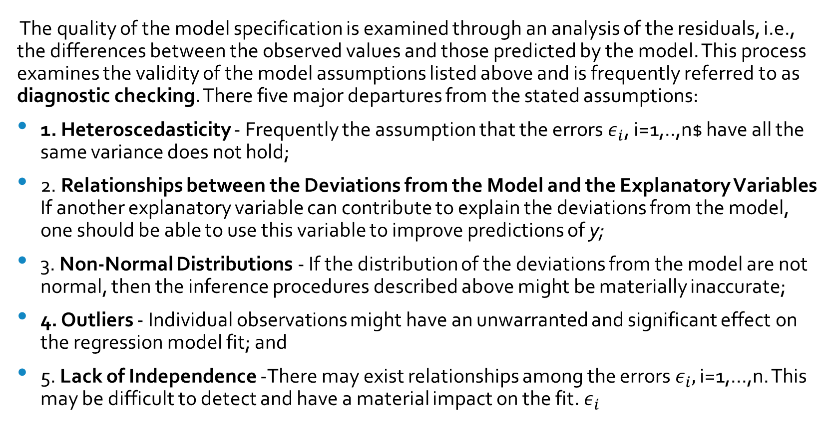
The Analysis of Residuals
The quality of the model specification is examined through an analysis of the residuals, i.e., the differences between the observed values and those predicted by the model. This process examines the validity of the model assumptions listed above and is frequently referred to as diagnostic checking. There five major departures from the stated assumptions:
1. Heteroscedasticity - Frequently the assumption that the errors $ε_{i}$, i=1,..,n$ have all the same variance does not hold;
2. Relationships between the Deviations from the Model and the Explanatory Variables If another explanatory variable can contribute to explain the deviations from the model, one should be able to use this variable to improve predictions of y;
3. Non-Normal Distributions - If the distribution of the deviations from the model are not normal, then the inference procedures described above might be materially inaccurate;
4. Outliers - Individual observations might have an unwarranted and significant effect on the regression model fit; and
5. Lack of Independence -There may exist relationships among the errors $ε_{i},$ i=1,...,n. This may be difficult to detect and have a material impact on the fit. $ε_{i}$

Slide 22
Teen Birth Rate and Poverty Level Data
The data set in the next slide shows, in the first two columns, the 2002 birth rate per 1000 females 15 to 17 years old, and the local (state) poverty rate, which is the percent of the state’s population living in households with incomes below the federally defined poverty level for the 50 states and the District of Columbia.

Slide 23
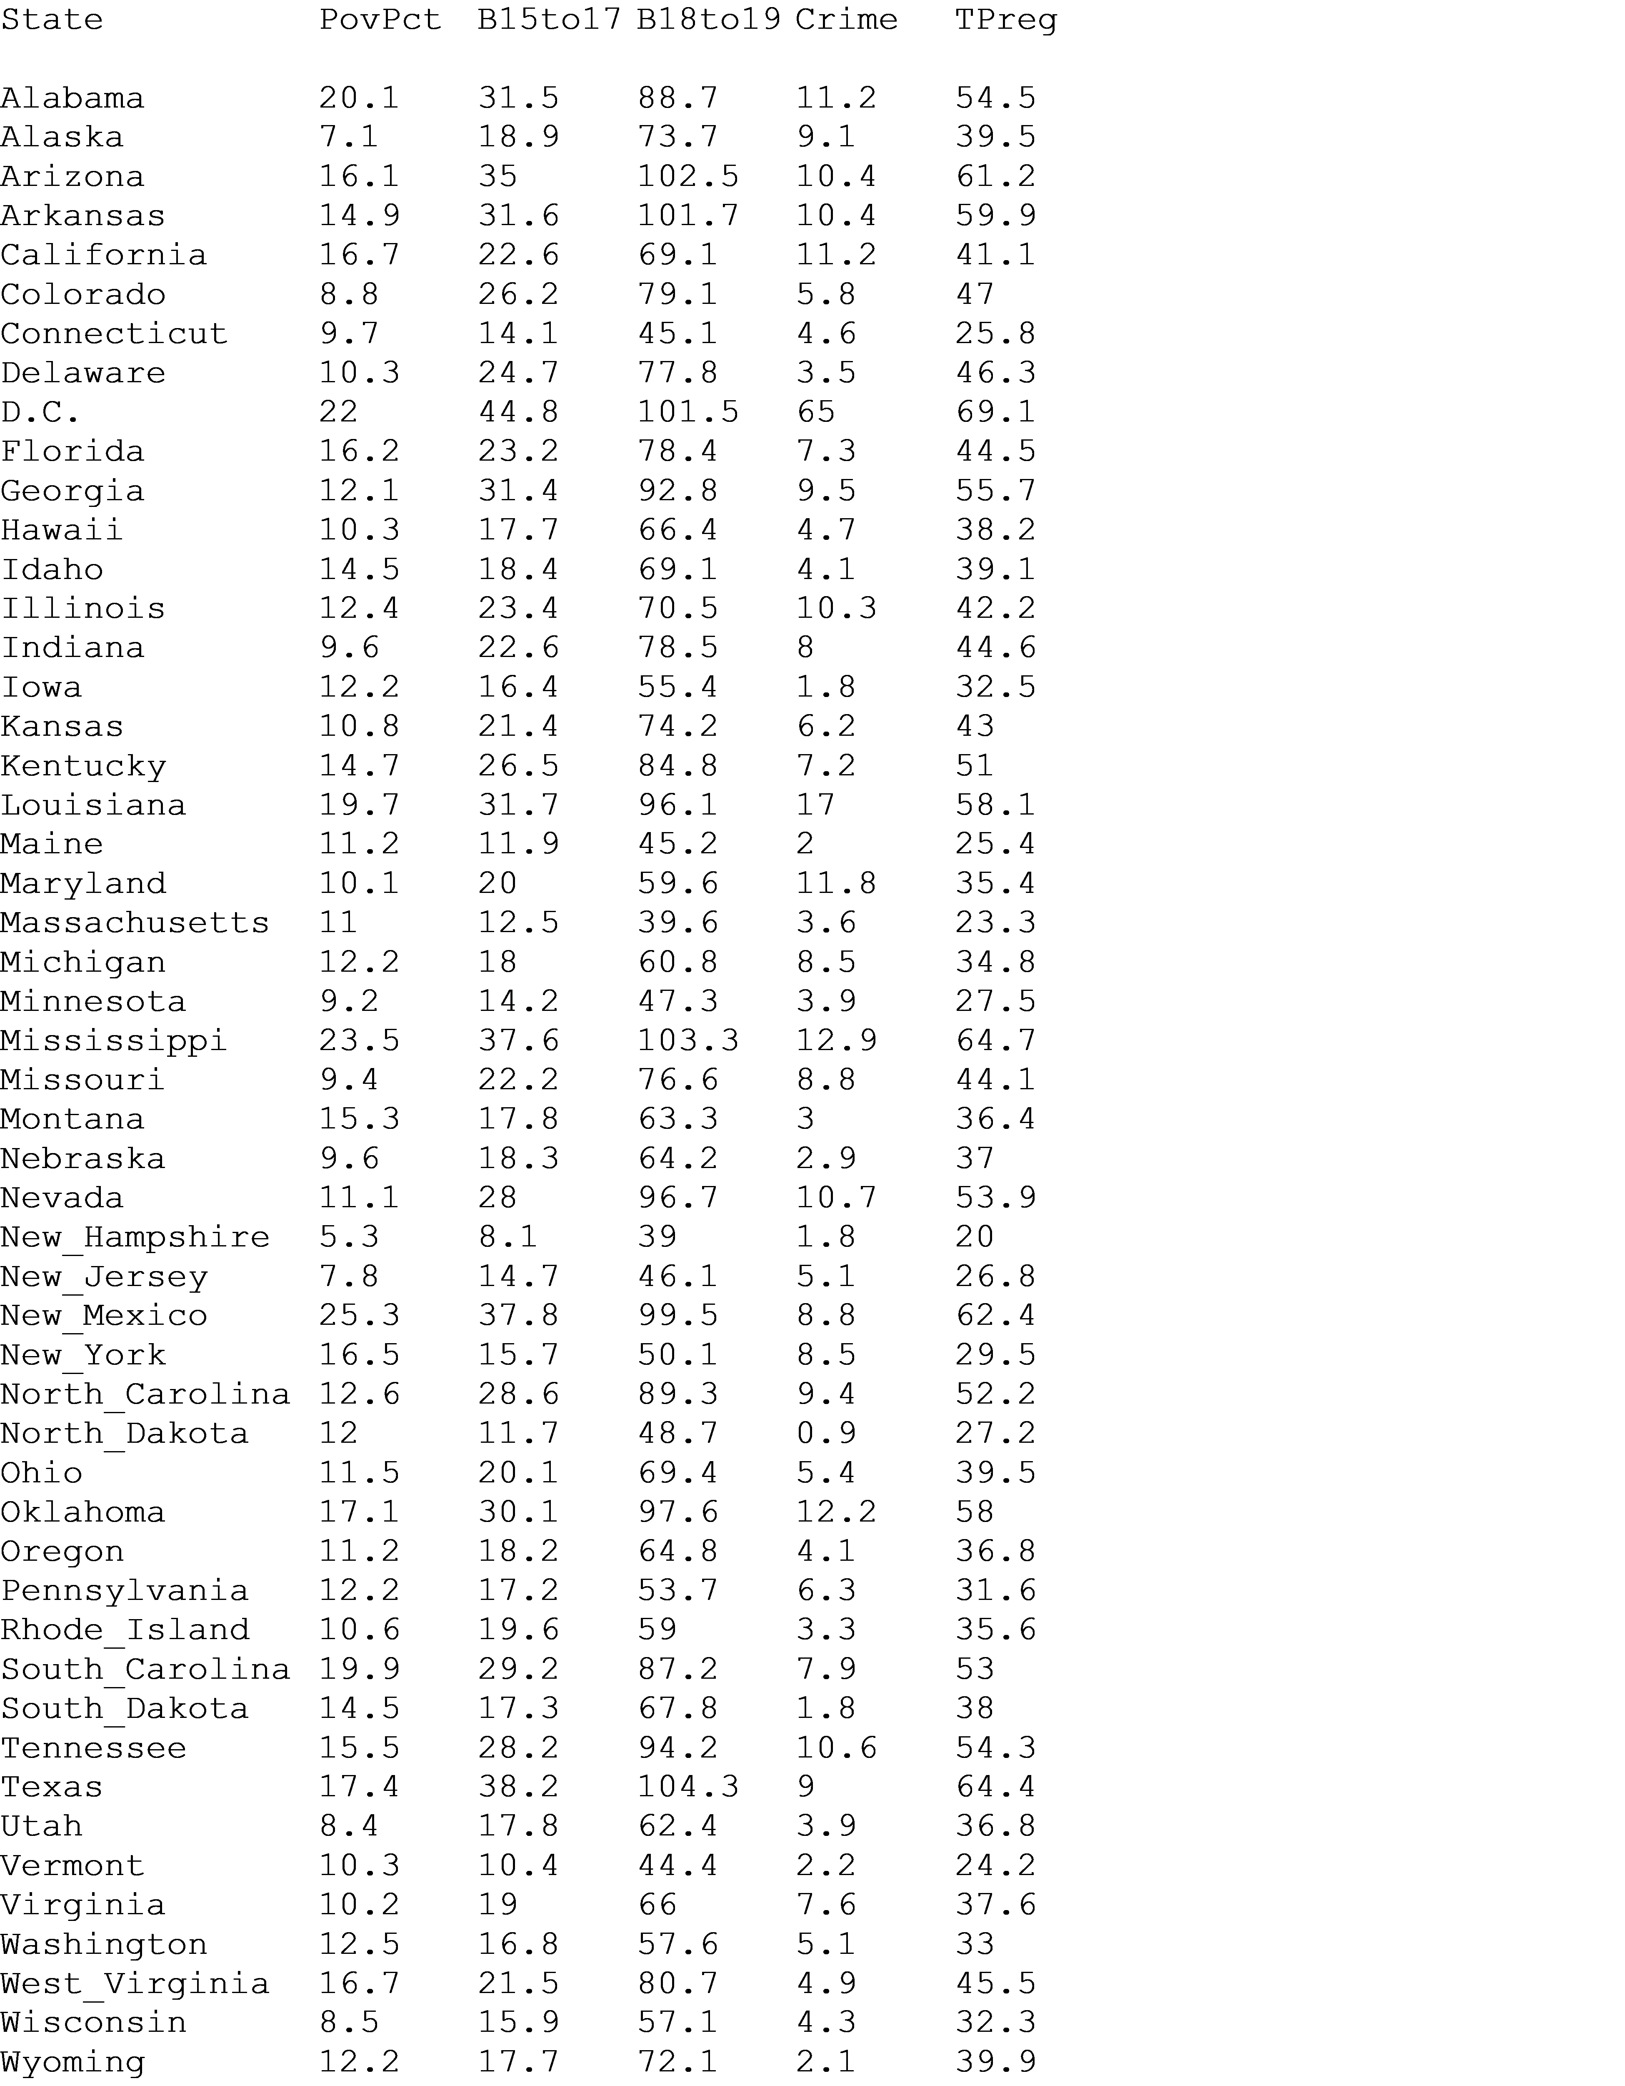
Teen Pregnancy in the US - 2002

Slide 24
Teen Pregnancy Rates and Poverty levels

Slide 25
Fitting a Model
Fitting a simple linear regression model to the data using some specialized software we obtain a summary such as:
Coefficients:
Estimate Std. Error t-value P(T > |t|)
(Intercept) 4.2673 (beta_0_hat) 2.5297 1.687 0.098
PovPct 1.3733 (beta_1_hat) 0.1835 7.483 1.19e-09
Residual standard error: 5.551 on 49 degrees of freedom
Multiple R-squared: 0.5333, Adjusted R-squared: 0.5238
F-statistic: 56 on 1 and 49 DF p-value:
Residuals:
Min 1Q Med 3Q Max
-11.2275 -3.6554 -0.0407 2.4972 10.5152

Slide 26
The Fitted Model
The fitted model, using the parameter estimates computed earlier, is shown below.

Slide 27
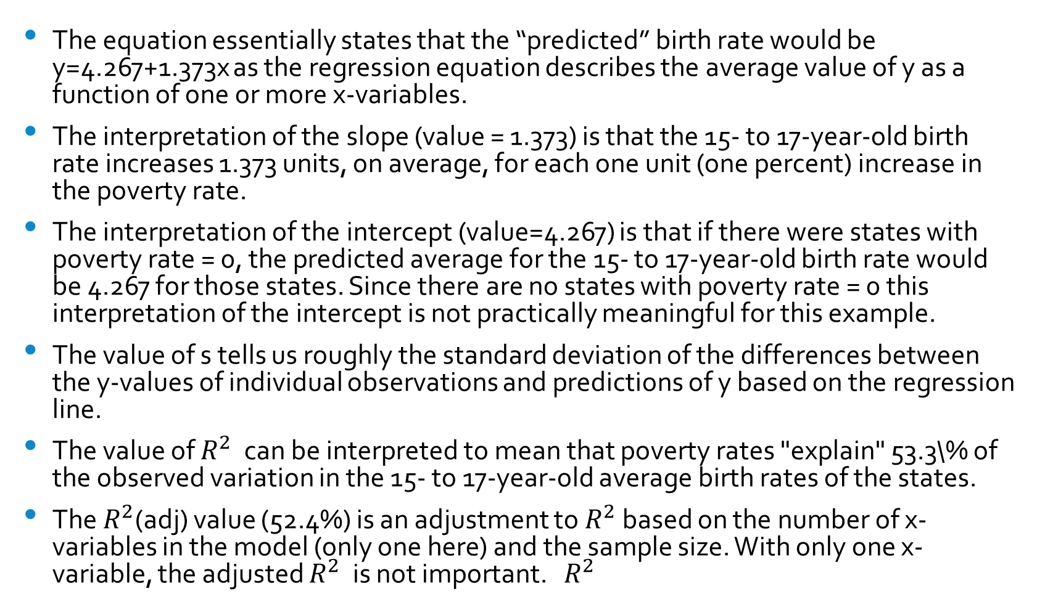
Summary
The equation essentially states that the “predicted” birth rate would be y=4.267+1.373x as the regression equation describes the average value of y as a function of one or more x-variables.
The interpretation of the slope (value = 1.373) is that the 15- to 17-year-old birth rate increases 1.373 units, on average, for each one unit (one percent) increase in the poverty rate.
The interpretation of the intercept (value=4.267) is that if there were states with poverty rate = 0, the predicted average for the 15- to 17-year-old birth rate would be 4.267 for those states. Since there are no states with poverty rate = 0 this interpretation of the intercept is not practically meaningful for this example.
The value of s tells us roughly the standard deviation of the differences between the y-values of individual observations and predictions of y based on the regression line.
The value of $R^{2}$ can be interpreted to mean that poverty rates "explain" 53.3\% of the observed variation in the 15- to 17-year-old average birth rates of the states.
The $R^{2}$(adj) value (52.4%) is an adjustment to $R^{2}$ based on the number of x-variables in the model (only one here) and the sample size. With only one x-variable, the adjusted $R^{2}$ is not important. $R^{2}$

Slide 28
Analysis of Residuals
The graph above shows the residuals, the differences between the observations and the predictions of the model, $y_{i}−\hat{y_{i}}$ plotted against the fitted values. There is no discernible pattern in the data. One can also plot the residuals against the predictor X.

Slide 29
Checking the Normality Assumption
To check the assumption of normality one could use a Q-Q plot. A Q-Q plot is a scatterplot created by plotting two sets of quantiles against one another. If both sets of quantiles came from the same distribution, we should see the points forming a line that's roughly straight. In the graph above the quantiles of the distribution of the residuals are plotted against the quantiles of the standard normal.

Slide 30
Galton’s Data
The graph below shows the original data collected by Galton on the relationship of the heights of parents and off-spring (Galton, F. (1886). Regression towards mediocrity in hereditary stature. The Journal of the Anthropological Institute of Great Britain and Ireland 15, 246–263).

Slide 31
Confidence Interval for the Fitted Line
The plot below shows the least squares fit to the data with a 95% confidence interval for the fitted line.

Slide 32
Multiple Regression Models
Introduction - In most situations of practical interest, we will have more than one variable that might impact the value of the response. Sales in a given store might be affected by its location, specific promotions, advertising expenditures, macroeconomic variables, etc. Multiple Linear Regression Models are class of models that include more than one predictor and are very frequently used to specify the relationship between these predictors and the response. Multiple Linear Regression Models will be the last major topic in the course.

Slide 33
Multiple Regression Models and the Simple Linear Regression Model
The good news is that everything we learned about the simple linear regression model extends — with at most minor modifications — to the multiple linear regression model. The models have almost identical assumptions. The only real difference is that whereas in simple linear regression we think of the distribution of errors at a fixed value of the single predictor, with multiple linear regression we have to think of the distribution of errors at a fixed set of values for all the predictors. All of the model checking procedures we learned earlier are useful in the multiple linear regression framework, although the process becomes more complex since we now have multiple predictors.

Slide 34
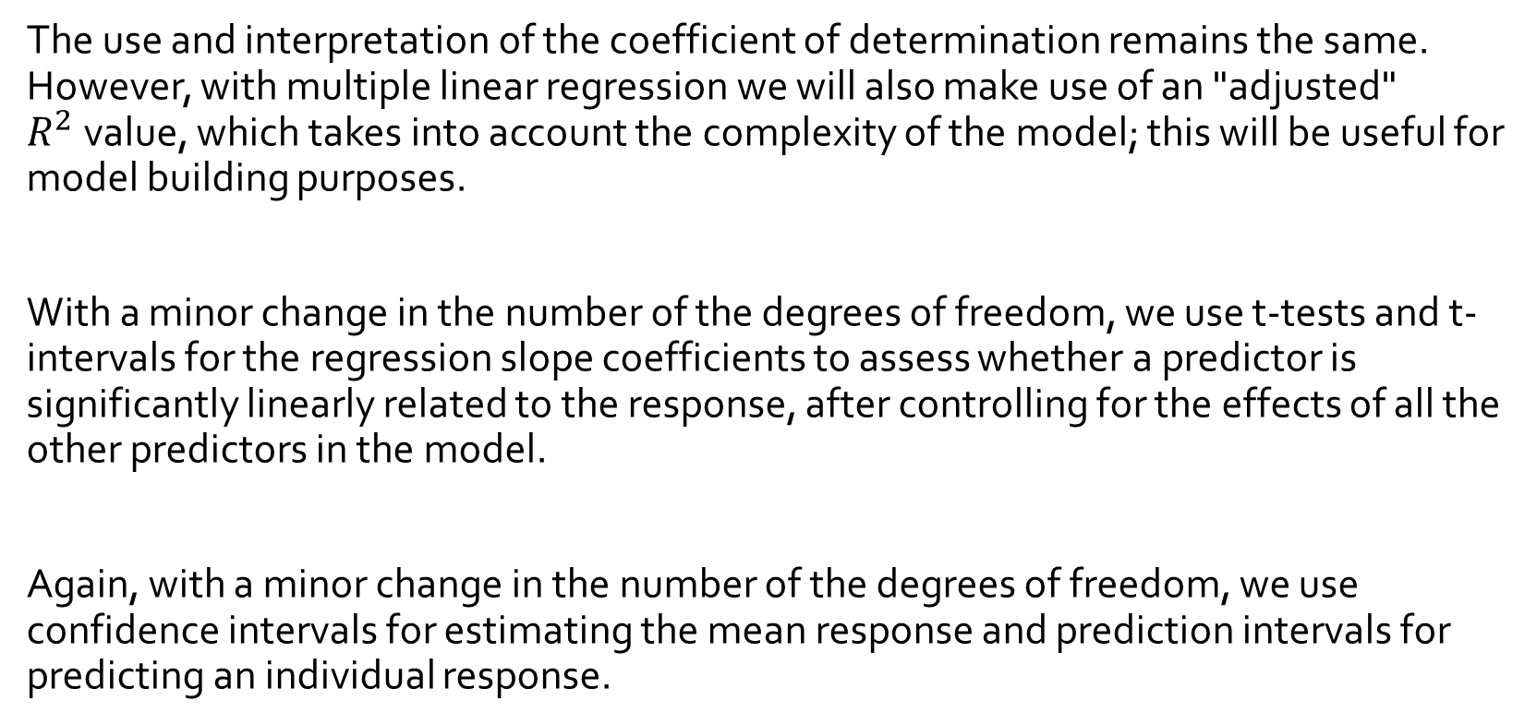
The Differences
The use and interpretation of the coefficient of determination remains the same. However, with multiple linear regression we will also make use of an "adjusted" $R^{2}$value, which takes into account the complexity of the model; this will be useful for model building purposes.
With a minor change in the number of the degrees of freedom, we use t-tests and t-intervals for the regression slope coefficients to assess whether a predictor is significantly linearly related to the response, after controlling for the effects of all the other predictors in the model.
Again, with a minor change in the number of the degrees of freedom, we use confidence intervals for estimating the mean response and prediction intervals for predicting an individual response.

Slide 35
The Tests
For the simple linear regression model, there is only one slope parameter about which one can perform hypothesis tests. For the multiple linear regression model, there are different hypothesis tests for slopes that one could conduct including:
a. a hypothesis test for testing that one slope parameter is equal to 0;
b. a hypothesis test for testing that all of the slope parameters are 0;
c. a hypothesis test for testing that a subset — more than one, but not all — of the slope parameters are 0

Slide 36
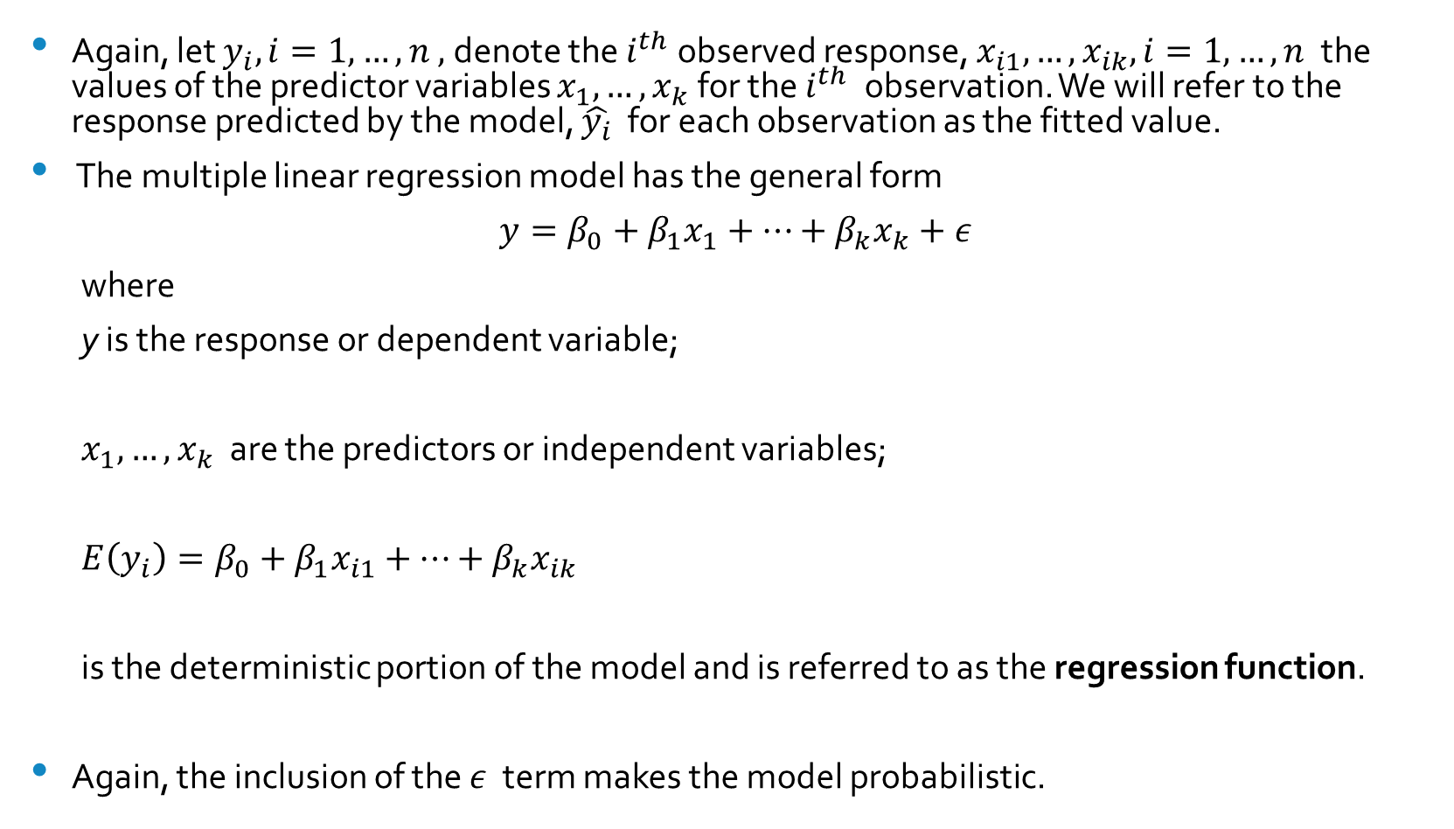
The Context
Again, let $y_{i},i=1,…,n ,$denote the $i^{th}$observed response, $x_{i1},…,x_{ik},i=1,…,n$ the values of the predictor variables $x_{1},…,x_{k}$for the $i^{th}$ observation. We will refer to the response predicted by the model, $\hat{y_{i}}$ for each observation as the fitted value.
The multiple linear regression model has the general form
$$y=β_{0}+β_{1}x_{1}+…+β_{k}x_{k}+ε$$
where
y is the response or dependent variable;
$x_{1},…,x_{k}$ are the predictors or independent variables;
$E\left(y_{i}\right)=β_{0}+β_{1}x_{i1}+…+β_{k}x_{ik}$
is the deterministic portion of the model and is referred to as the regression function.
Again, the inclusion of the $ε$ term makes the model probabilistic.

Slide 37
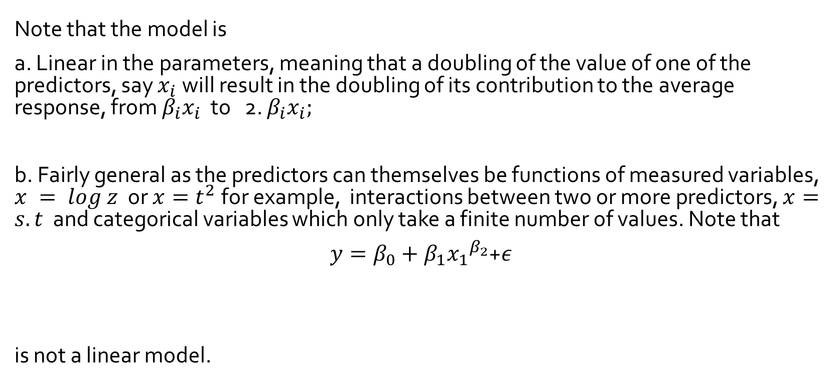
How is the model linear?
Note that the model is
a. Linear in the parameters, meaning that a doubling of the value of one of the predictors, say $x_{i}$will result in the doubling of its contribution to the average response, from $β_{i}x_{i}$ to 2. $β_{i}x_{i};$
b. Fairly general as the predictors can themselves be functions of measured variables, $x = log z$ or $x=t^{2}$for example, interactions between two or more predictors, $x=s.t$ and categorical variables which only take a finite number of values. Note that
$y=β_{0}+β_{1}{x_{1}}^{β_{2}}$+$ε$
is not a linear model.

Slide 38
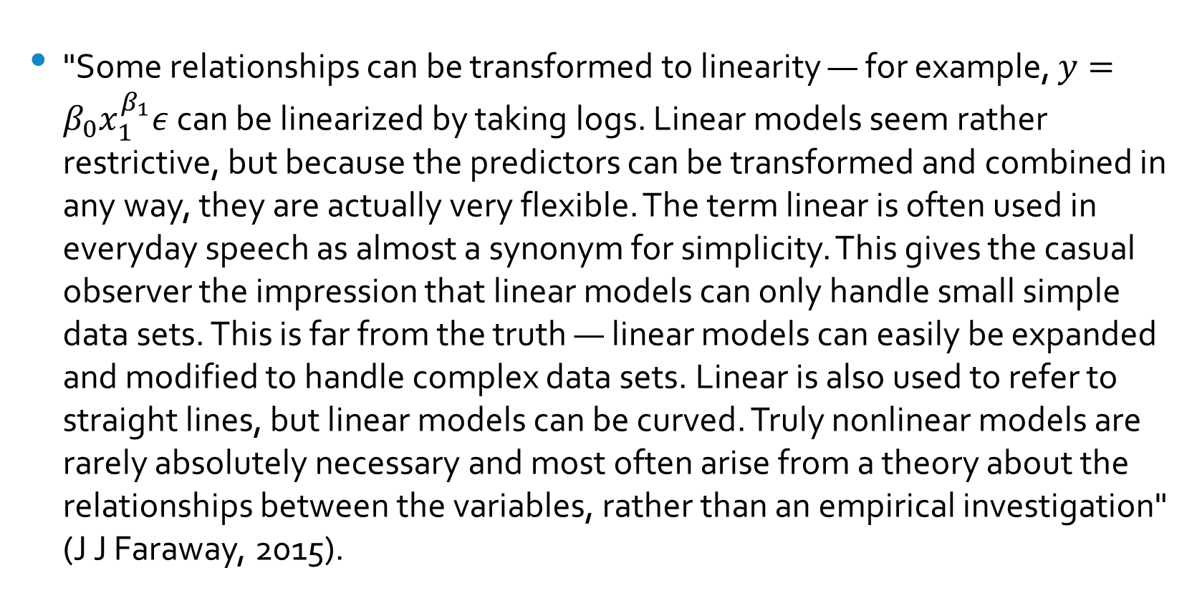
Linear Regression Models are Very Flexible
"Some relationships can be transformed to linearity — for example, $y=β_{0}x_{1}^{β_{1}}ε$ can be linearized by taking logs. Linear models seem rather restrictive, but because the predictors can be transformed and combined in any way, they are actually very flexible. The term linear is often used in everyday speech as almost a synonym for simplicity. This gives the casual observer the impression that linear models can only handle small simple data sets. This is far from the truth — linear models can easily be expanded and modified to handle complex data sets. Linear is also used to refer to straight lines, but linear models can be curved. Truly nonlinear models are rarely absolutely necessary and most often arise from a theory about the relationships between the variables, rather than an empirical investigation" (J J Faraway, 2015).

Slide 39
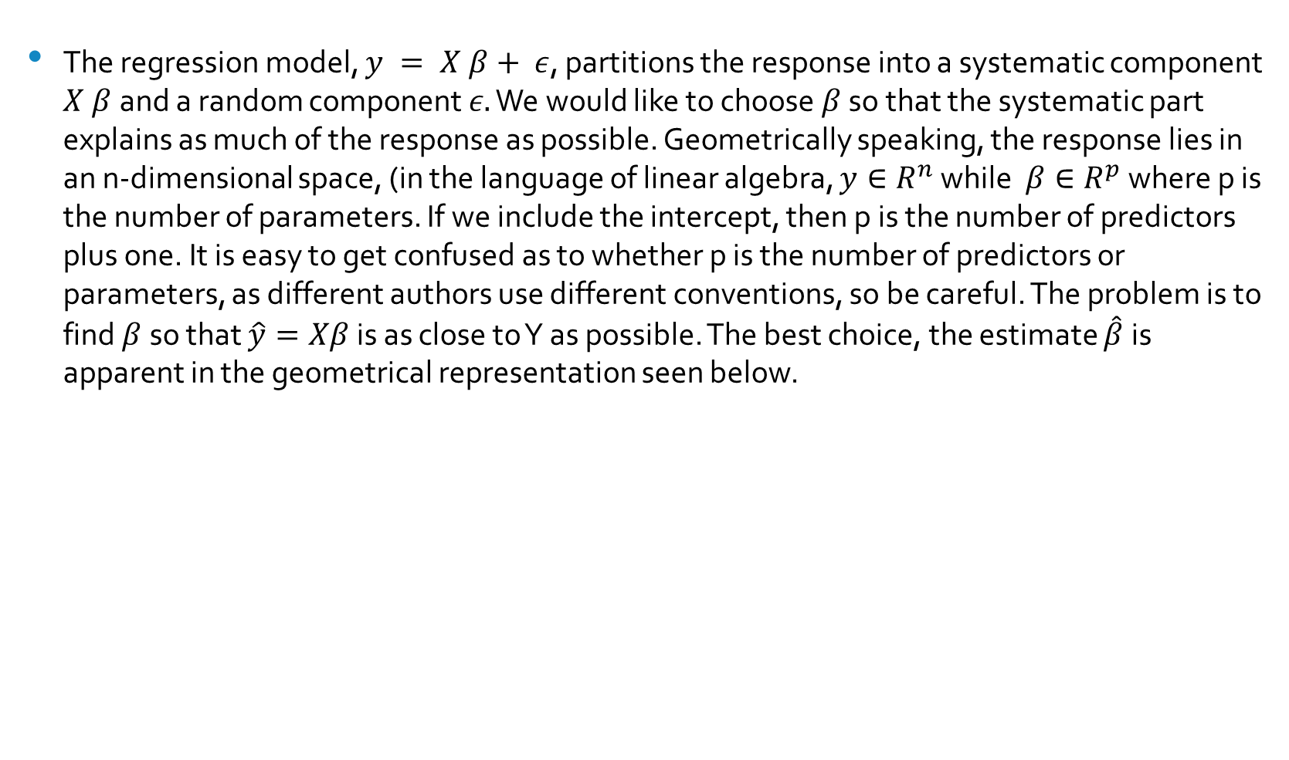
Parameter Estimation
The regression model, $y = X β+ ε$, partitions the response into a systematic component $X β$and a random component $ε.$ We would like to choose $β$ so that the systematic part explains as much of the response as possible. Geometrically speaking, the response lies in an n-dimensional space, (in the language of linear algebra, $y∈R^{n}$ while $β∈R^{p}$ where p is the number of parameters. If we include the intercept, then p is the number of predictors plus one. It is easy to get confused as to whether p is the number of predictors or parameters, as different authors use different conventions, so be careful. The problem is to find $β$so that $\hat{y}=Xβ$is as close to Y as possible. The best choice, the estimate $\hat{β}$is apparent in the geometrical representation seen below.

Slide 40
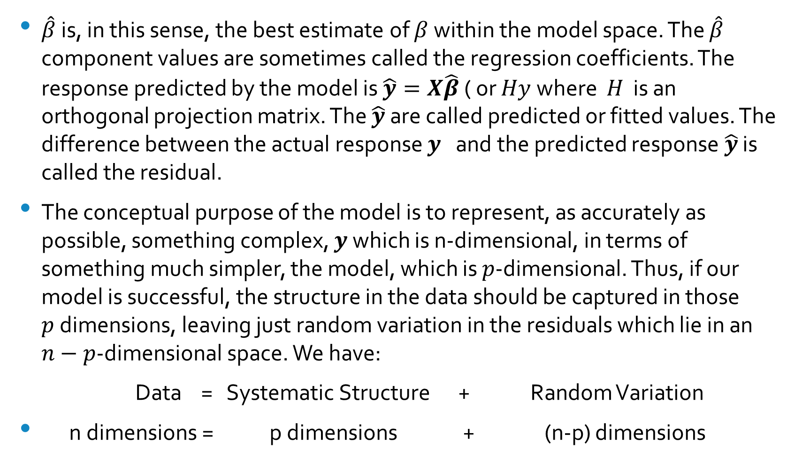
Best Estimates
$\hat{β}$ is, in this sense, the best estimate of $β$ within the model space. The $\hat{β}$ component values are sometimes called the regression coefficients. The response predicted by the model is $\hat{y}=X\hat{β}$ ( or $Hy$where $H$ is an orthogonal projection matrix. The $\hat{y}$ are called predicted or fitted values. The difference between the actual response $y$ and the predicted response $\hat{y}$ is called the residual.
The conceptual purpose of the model is to represent, as accurately as possible, something complex, $y$ which is n-dimensional, in terms of something much simpler, the model, which is $p$-dimensional. Thus, if our model is successful, the structure in the data should be captured in those $p$dimensions, leaving just random variation in the residuals which lie in an $n−p$-dimensional space. We have:
Data = Systematic Structure + Random Variation
n dimensions = p dimensions + (n-p) dimensions

Slide 41
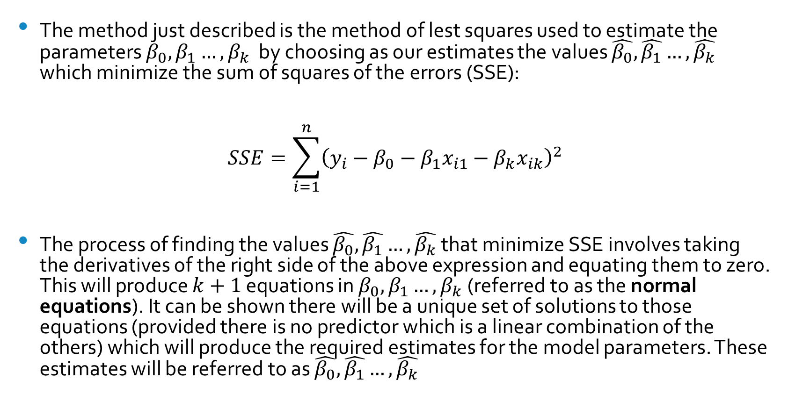
Least Squares Estimates
The method just described is the method of lest squares used to estimate the parameters $β_{0},β_{1}…,β_{k}$ by choosing as our estimates the values $\hat{β_{0}},\hat{β_{1}}…,\hat{β_{k}}$ which minimize the sum of squares of the errors (SSE):
$$SSE=\sum_{i=1}^{n}{{\left(y_{i}−β_{0}−β_{1}x_{i1}−β_{k}x_{ik}\right)}^{2}}$$
The process of finding the values $\hat{β_{0}},\hat{β_{1}}…,\hat{β_{k}}$ that minimize SSE involves taking the derivatives of the right side of the above expression and equating them to zero. This will produce $k+1$ equations in $β_{0},β_{1}…,β_{k}$(referred to as the normal equations). It can be shown there will be a unique set of solutions to those equations (provided there is no predictor which is a linear combination of the others) which will produce the required estimates for the model parameters. These estimates will be referred to as $\hat{β_{0}},\hat{β_{1}}…,\hat{β_{k}}$

Slide 42
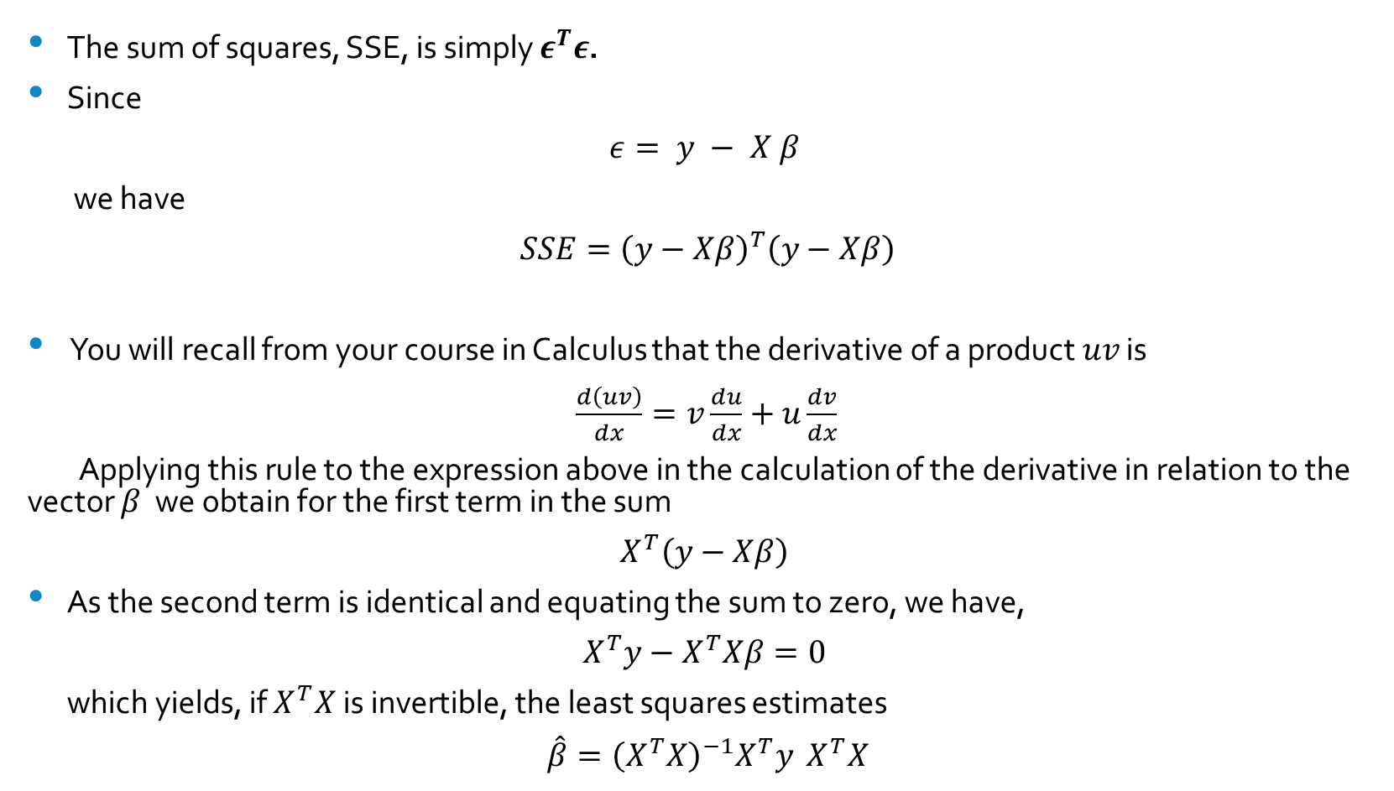
The Algebra
The sum of squares, SSE, is simply $ε^{T}ε$.
Since
$$ε= y − X β$$
we have
$SSE={\left(y−Xβ\right)}^{T}\left(y−Xβ\right)$
You will recall from your course in Calculus that the derivative of a product $uv$ is
$\frac{d\left(uv\right)}{dx}=v\frac{du}{dx}+u\frac{dv}{dx}$
Applying this rule to the expression above in the calculation of the derivative in relation to the vector $β$ we obtain for the first term in the sum
$X^{T}\left(y−Xβ\right)$
As the second term is identical and equating the sum to zero, we have,
$$X^{T}y−X^{T}Xβ=0$$
which yields, if $X^{T}X$is invertible, the least squares estimates
$\hat{β}={\left(X^{T}X\right)}^{−1}X^{T}y$ $X^{T}X$

Slide 43
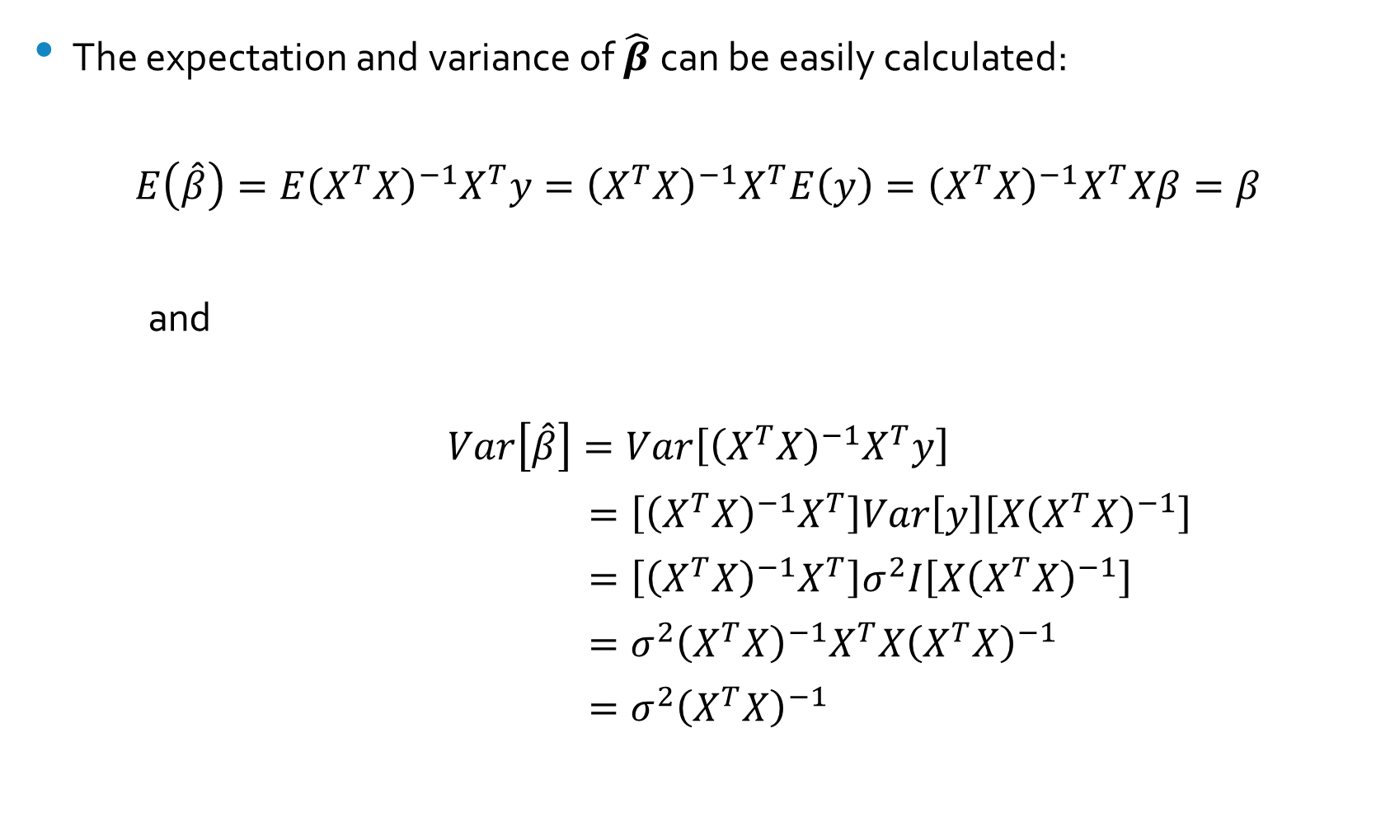
Expectations and Variances
The expectation and variance of $\hat{β}$can be easily calculated:
$$E\left(\hat{β}\right)=E{\left(X^{T}X\right)}^{−1}X^{T}y={\left(X^{T}X\right)}^{−1}X^{T}E\left(y\right)={\left(X^{T}X\right)}^{−1}X^{T}Xβ=β$$
and
$$Var\left[\hat{β}\right]=Var\left[{\left(X^{T}X\right)}^{−1}X^{T}y\right]$$
$=\left[{\left(X^{T}X\right)}^{−1}X^{T}\right]Var\left[y\right]\left[X{\left(X^{T}X\right)}^{−1}\right]$
$=\left[{\left(X^{T}X\right)}^{−1}X^{T}\right]σ^{2}I\left[X{\left(X^{T}X\right)}^{−1}\right]$
$=σ^{2}{\left(X^{T}X\right)}^{−1}X^{T}X{\left(X^{T}X\right)}^{−1}$
$=σ^{2}{\left(X^{T}X\right)}^{−1}$

Slide 44
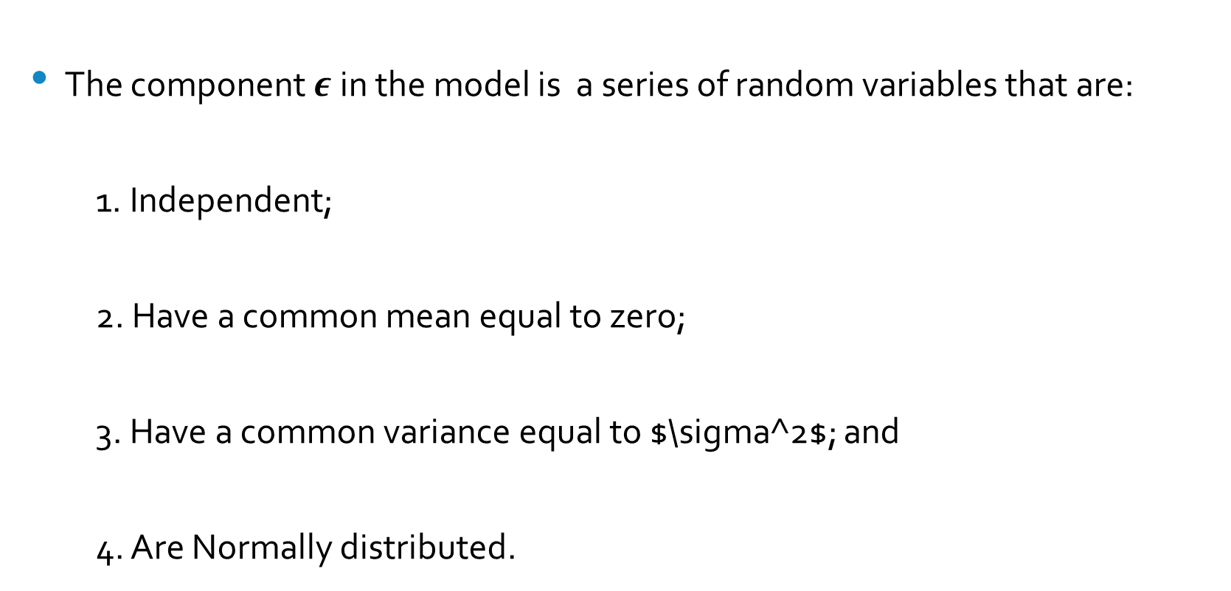
Model Assumptions
The component $ε$in the model is a series of random variables that are:
1. Independent;
2. Have a common mean equal to zero;
3. Have a common variance equal to $\sigma^2$; and
4. Are Normally distributed.

Slide 45
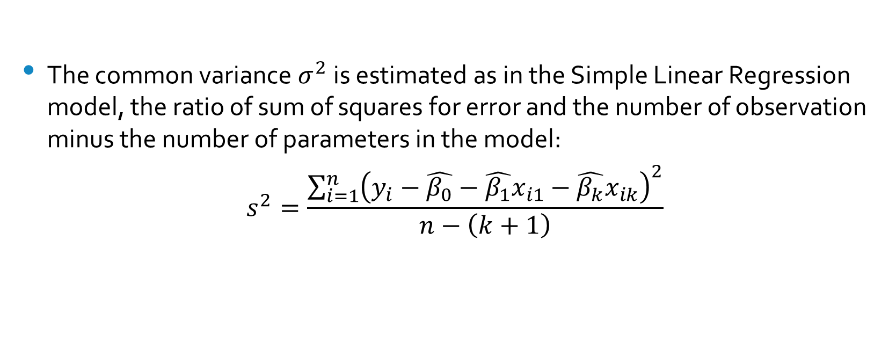
Estimating the Variance $σ^{2}$
The common variance $σ^{2}$is estimated as in the Simple Linear Regression model, the ratio of sum of squares for error and the number of observation minus the number of parameters in the model:
$$s^{2}=\frac{\sum_{i=1}^{n}{{\left(y_{i}−\hat{β_{0}}−\hat{β_{1}}x_{i1}−\hat{β_{k}}x_{ik}\right)}^{2}}}{n−\left(k+1\right)}$$

Slide 46
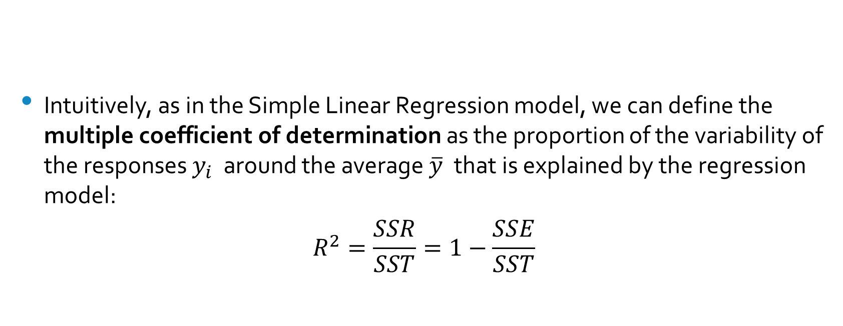
The Coefficient of Determination
Intuitively, as in the Simple Linear Regression model, we can define the multiple coefficient of determination as the proportion of the variability of the responses $y_{i}$ around the average $\overline{y}$ that is explained by the regression model:
$$R^{2}=\frac{SSR}{SST}=1−\frac{SSE}{SST}$$

Slide 47
The Analysis of Variance Table
As in the case of the Simple Linear Regression Model we can decompose the variability of the responses into components associated with the Regression and with the Errors:
ANOVA Table
Source Sum of Squares df Mean Square
Regression SSR k Regression MS
Error SSE n-(k+1) MSE
Total SST n-1

Slide 48
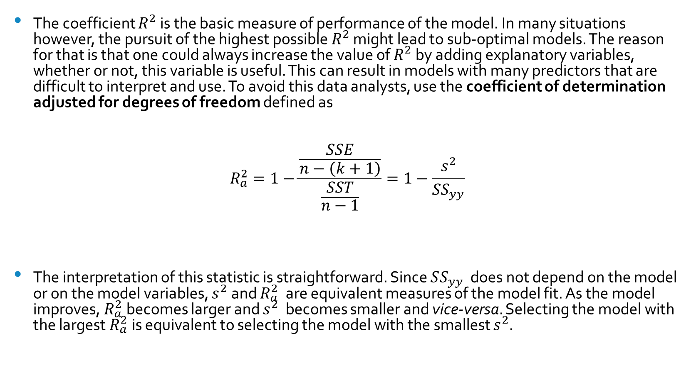

The Adjusted $R^{2}$
The coefficient $R^{2}$is the basic measure of performance of the model. In many situations however, the pursuit of the highest possible $R^{2}$ might lead to sub-optimal models. The reason for that is that one could always increase the value of $R^{2}$ by adding explanatory variables, whether or not, this variable is useful. This can result in models with many predictors that are difficult to interpret and use. To avoid this data analysts, use the coefficient of determination adjusted for degrees of freedom defined as
$$R_{a}^{2}=1−\frac{\frac{SSE}{n−\left(k+1\right)}}{\frac{SST}{n−1}}=1−\frac{s^{2}}{SS_{yy}}$$
The interpretation of this statistic is straightforward. Since $SS_{yy}$ does not depend on the model or on the model variables, $s^{2}$and $R_{a}^{2}$ are equivalent measures of the model fit. As the model improves, $R_{a}^{2}$becomes larger and $s^{2}$ becomes smaller and vice-versa. Selecting the model with the largest $R_{a}^{2}$is equivalent to selecting the model with the smallest $s^{2}$.

Slide 49
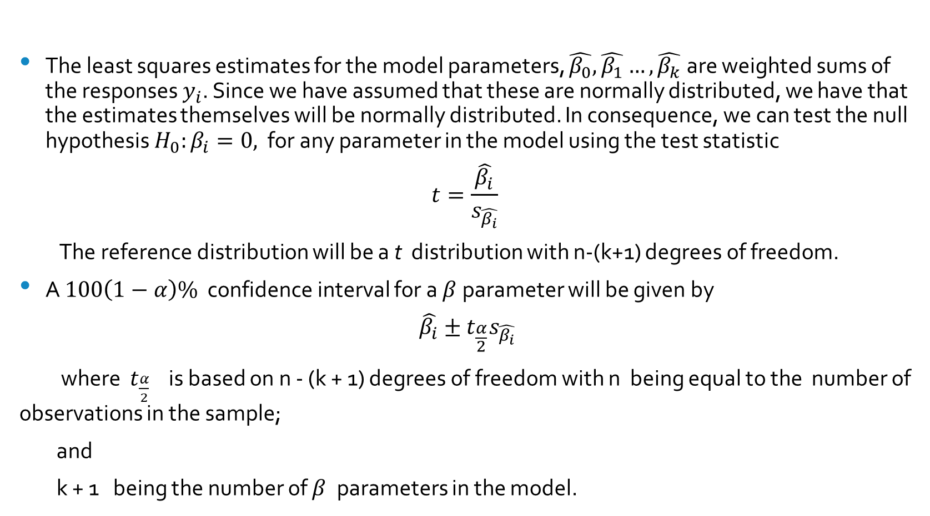
Inference about a Single Parameter
The least squares estimates for the model parameters, $\hat{β_{0}},\hat{β_{1}}…,\hat{β_{k}}$ are weighted sums of the responses $y_{i}$. Since we have assumed that these are normally distributed, we have that the estimates themselves will be normally distributed. In consequence, we can test the null hypothesis $H_{0}:β_{i}=0,$ for any parameter in the model using the test statistic
$$t=\frac{\hat{β_{i}}}{s_{\hat{β_{i}}}}$$
The reference distribution will be a t distribution with n-(k+1) degrees of freedom.
A $100\left(1−α\right)\%$ confidence interval for a $β$parameter will be given by
$$\hat{β_{i}}±t_{\frac{α}{2}}s_{\hat{β_{i}}}$$
where $t_{\frac{α}{2}}$ is based on n - (k + 1) degrees of freedom with n being equal to the number of observations in the sample;
and
k + 1 being the number of $β$ parameters in the model.

Slide 50
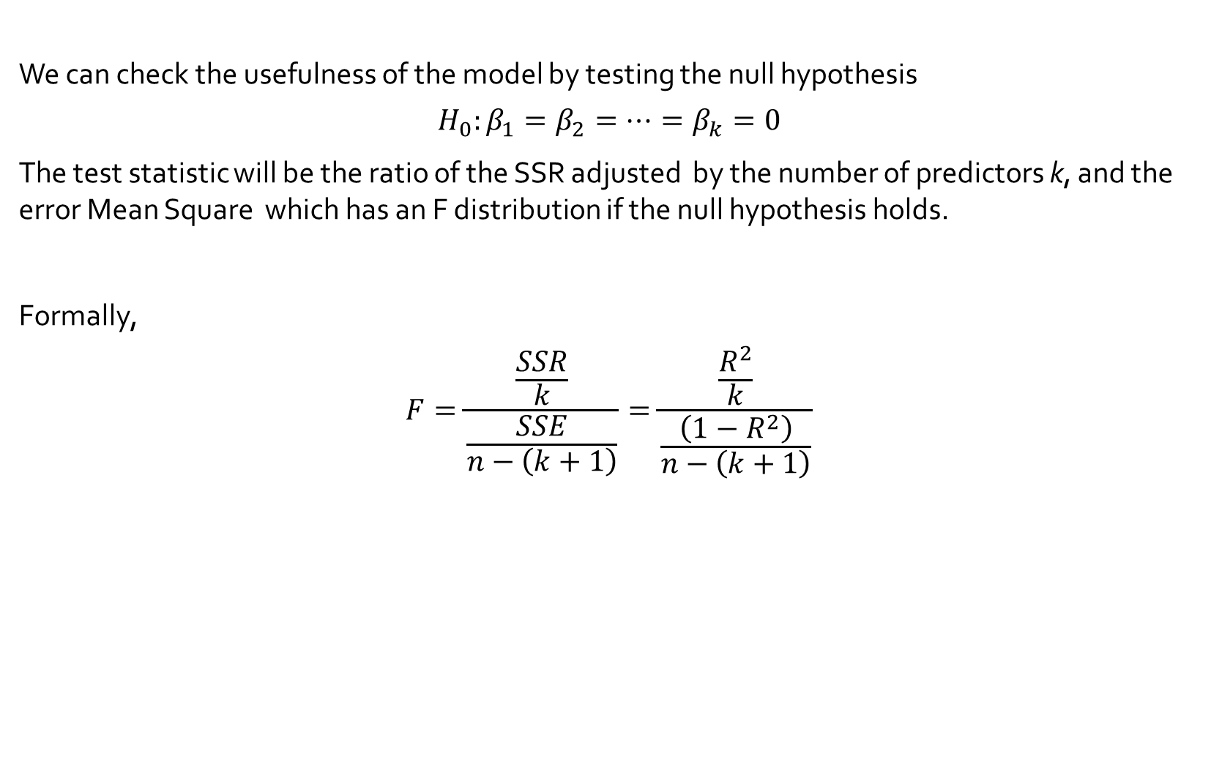
Is the Model Useful
We can check the usefulness of the model by testing the null hypothesis
$$H_{0}:β_{1}=β_{2}=…=β_{k}=0$$
The test statistic will be the ratio of the SSR adjusted by the number of predictors k, and the error Mean Square which has an F distribution if the null hypothesis holds.
Formally,
$$F=\frac{\frac{SSR}{k}}{\frac{SSE}{n−\left(k+1\right)}}=\frac{\frac{R^{2}}{k}}{\frac{\left(1−R^{2}\right)}{n−\left(k+1\right)}}$$

Slide 51
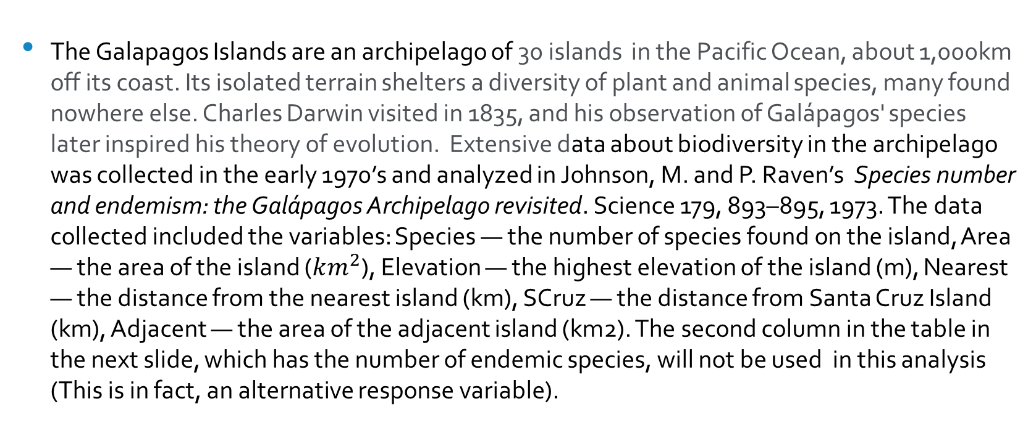
Biodiversity in the Galapagos Islands
The Galapagos Islands are an archipelago of 30 islands in the Pacific Ocean, about 1,000km off its coast. Its isolated terrain shelters a diversity of plant and animal species, many found nowhere else. Charles Darwin visited in 1835, and his observation of Galápagos' species later inspired his theory of evolution. Extensive data about biodiversity in the archipelago was collected in the early 1970’s and analyzed in Johnson, M. and P. Raven’s Species number and endemism: the Galápagos Archipelago revisited. Science 179, 893–895, 1973. The data collected included the variables: Species — the number of species found on the island, Area — the area of the island ($km^{2}$), Elevation — the highest elevation of the island (m), Nearest — the distance from the nearest island (km), SCruz — the distance from Santa Cruz Island (km), Adjacent — the area of the adjacent island (km2). The second column in the table in the next slide, which has the number of endemic species, will not be used in this analysis (This is in fact, an alternative response variable).

Slide 52
Biodiversity in The Galapagos Islands
Species | Endemics | Area | Elevation | Nearest | Scruz | Adjacent
58 | 23 | 25.09 | 346 | 0.6 | 0.6 | 1.84
31 | 21 | 1.24 | 109 | 0.6 | 26.3 | 572.33
3 | 3 | 0.21 | 114 | 2.8 | 58.7 | 0.78
25 | 9 | 0.1 | 46 | 1.9 | 47.4 | 0.18
2 | 1 | 0.05 | 77 | 1.9 | 1.9 | 903.82
18 | 11 | 0.34 | 119 | 8 | 8 | 1.84
24 | 0 | 0.08 | 93 | 6 | 12 | 0.34
10 | 7 | 2.33 | 168 | 34.1 | 290.2 | 2.85
8 | 4 | 0.03 | 71 | 0.4 | 0.4 | 17.95
2 | 2 | 0.18 | 112 | 2.6 | 50.2 | 0.1
97 | 26 | 58.27 | 198 | 1.1 | 88.3 | 0.57
93 | 35 | 634.49 | 1494 | 4.3 | 95.3 | 4669.32
58 | 17 | 0.57 | 49 | 1.1 | 93.1 | 58.27
5 | 4 | 0.78 | 227 | 4.6 | 62.2 | 0.21
40 | 19 | 17.35 | 76 | 47.4 | 92.2 | 129.49
347 | 89 | 4669.32 | 1707 | 0.7 | 28.1 | 634.49
51 | 23 | 129.49 | 343 | 29.1 | 85.9 | 59.56
2 | 2 | 0.01 | 25 | 3.3 | 45.9 | 0.1
104 | 37 | 59.56 | 777 | 29.1 | 119.6 | 129.49
108 | 33 | 17.95 | 458 | 10.7 | 10.7 | 0.03
12 | 9 | 0.23 | 94 | 0.5 | 0.6 | 25.09
70 | 30 | 4.89 | 367 | 4.4 | 24.4 | 572.33
280 | 65 | 551.62 | 716 | 45.2 | 66.6 | 0.57
237 | 81 | 572.33 | 906 | 0.2 | 19.8 | 4.89
444 | 95 | 903.82 | 864 | 0.6 | 0 | 0.52
62 | 28 | 24.08 | 259 | 16.5 | 16.5 | 0.52
285 | 73 | 170.92 | 640 | 2.6 | 49.2 | 0.1
44 | 16 | 1.84 | 147 | 0.6 | 9.6 | 25.09
16 | 8 | 1.24 | 186 | 6.8 | 50.9 | 17.95
21 | 12 | 2.85 | 253 | 34.1 | 254.7 | 2.33

Slide 53
Analysis
It is always a good idea to look at the data before attempting any formal model building exercise. An exploratory analysis of the data my reveal special aspects of the data you may want to keep an eye on. In the the graphs below, we plot a histogram of the number of species in the various islands and of the maximum elevation in each of them.

Slide 54
Elevation

Slide 55
More Plots

Slide 56
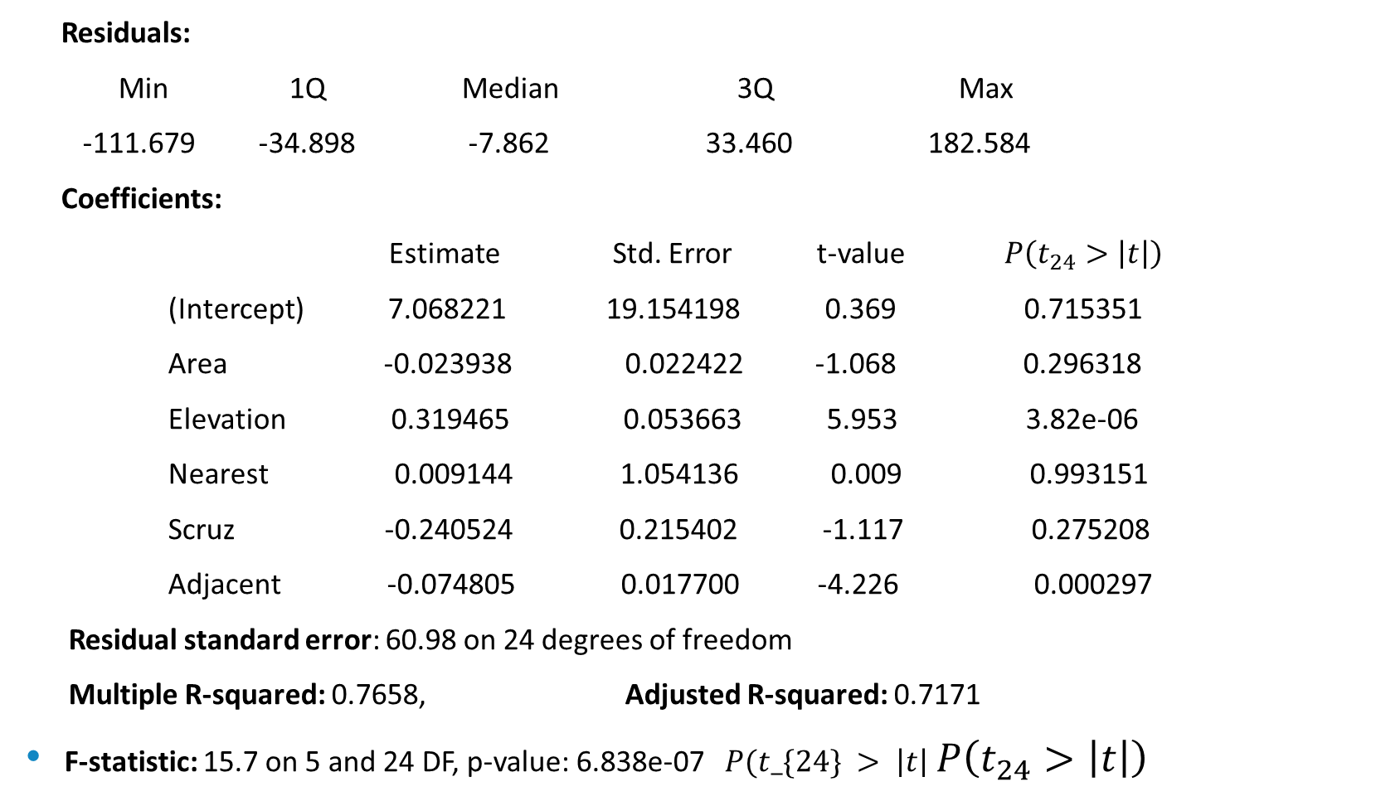
Model Fitting
Residuals:
Min 1Q Median 3Q Max
-111.679 -34.898 -7.862 33.460 182.584
Coefficients:
Estimate Std. Error t-value $P\left(t_{24}>\left|t\right|\right)$
(Intercept) 7.068221 19.154198 0.369 0.715351
Area -0.023938 0.022422 -1.068 0.296318
Elevation 0.319465 0.053663 5.953 3.82e-06
Nearest 0.009144 1.054136 0.009 0.993151
Scruz -0.240524 0.215402 -1.117 0.275208
Adjacent -0.074805 0.017700 -4.226 0.000297
Residual standard error: 60.98 on 24 degrees of freedom
Multiple R-squared: 0.7658, Adjusted R-squared: 0.7171
F-statistic: 15.7 on 5 and 24 DF, p-value: 6.838e-07 $P(t_\{24\} > \left|t\right|$ $P\left(t_{24}>\left|t\right|\right)$

Slide 57
Analysis
The first thing one may want to do is to look at the residuals. There are several ways to do this. Are they normally distributed? We can plot their histogram:

Slide 58
Analysis
Or look at the Q-Q plot

Slide 59
Analysis
and always plot them against the fitted values:

Slide 60
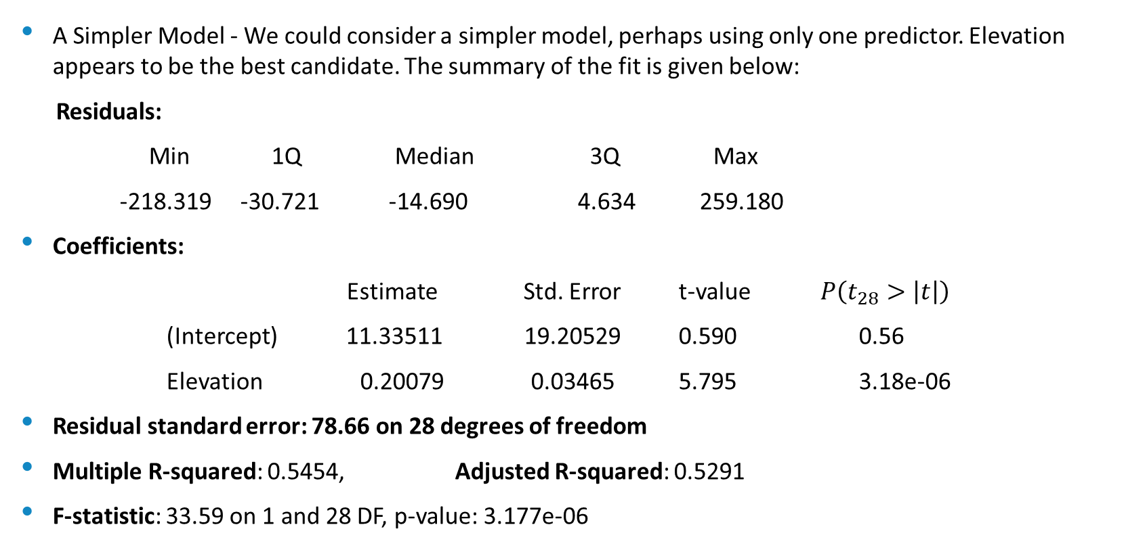
A Simpler Model
A Simpler Model - We could consider a simpler model, perhaps using only one predictor. Elevation appears to be the best candidate. The summary of the fit is given below:
Residuals:
Min 1Q Median 3Q Max
-218.319 -30.721 -14.690 4.634 259.180
Coefficients:
Estimate Std. Error t-value $P\left(t_{28}>\left|t\right|\right)$
(Intercept) 11.33511 19.20529 0.590 0.56
Elevation 0.20079 0.03465 5.795 3.18e-06
Residual standard error: 78.66 on 28 degrees of freedom
Multiple R-squared: 0.5454, Adjusted R-squared: 0.5291
F-statistic: 33.59 on 1 and 28 DF, p-value: 3.177e-06

Slide 61
Analysis of Residuals

Slide 62
Q-Q Plot

Slide 63
Residuals Plot
As usual, we plot the residuals against the fitted values:

Slide 64
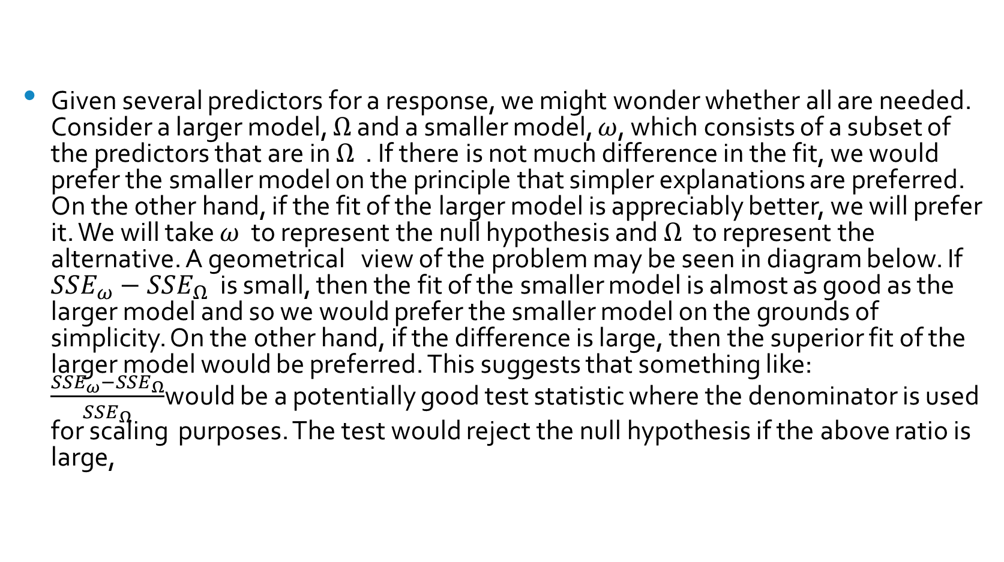
The F-test
Given several predictors for a response, we might wonder whether all are needed. Consider a larger model, $Ω$ and a smaller model, $ω$, which consists of a subset of the predictors that are in $Ω$ . If there is not much difference in the fit, we would prefer the smaller model on the principle that simpler explanations are preferred. On the other hand, if the fit of the larger model is appreciably better, we will prefer it. We will take $ω$ to represent the null hypothesis and $Ω$ to represent the alternative. A geometrical view of the problem may be seen in diagram below. If $SSE_{ω}−SSE_{Ω}$ is small, then the fit of the smaller model is almost as good as the larger model and so we would prefer the smaller model on the grounds of simplicity. On the other hand, if the difference is large, then the superior fit of the larger model would be preferred. This suggests that something like: $\frac{SSE_{ω}−SSE_{Ω}}{SSE_{Ω}}$would be a potentially good test statistic where the denominator is used for scaling purposes. The test would reject the null hypothesis if the above ratio is large,

Slide 65
The F-test (continued)

Slide 66
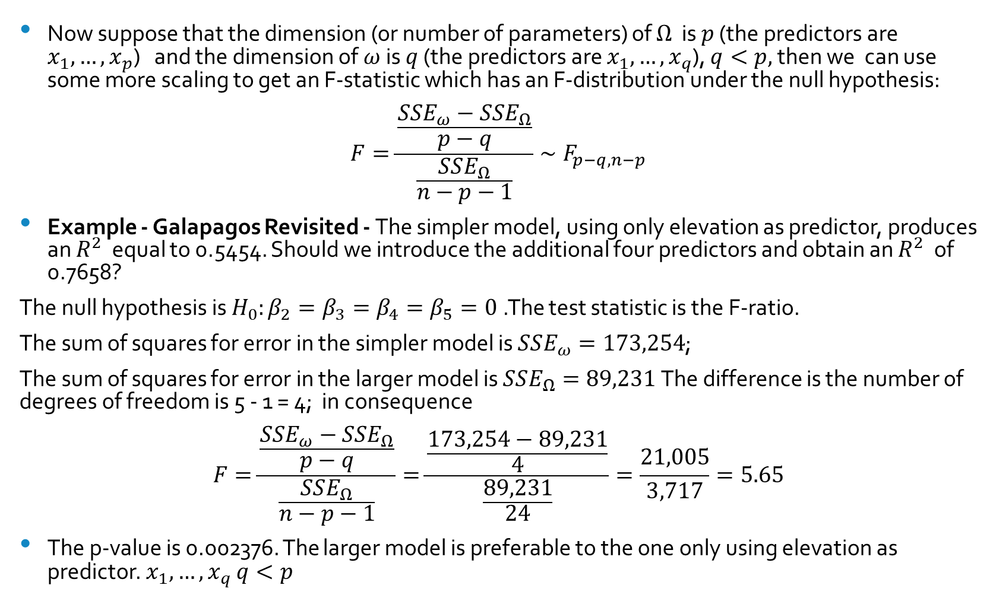
The F-test (Continued)
Now suppose that the dimension (or number of parameters) of $Ω$ is $p$ (the predictors are $x_{1},…,x_{p}$) and the dimension of $ω$is $q$ (the predictors are $x_{1},…,x_{q}$), $q<p,$ then we can use some more scaling to get an F-statistic which has an F-distribution under the null hypothesis:
$$F=\frac{\frac{SSE_{ω}−SSE_{Ω}}{p−q}}{\frac{SSE_{Ω}}{n−p−1}}∼F_{p−q,n−p}$$
Example - Galapagos Revisited - The simpler model, using only elevation as predictor, produces an $R^{2}$ equal to 0.5454. Should we introduce the additional four predictors and obtain an $R^{2}$ of 0.7658?
The null hypothesis is $H_{0}:β_{2}=β_{3}=β_{4}=β_{5}=0$.The test statistic is the F-ratio.
The sum of squares for error in the simpler model is $SSE_{ω}=173,254$;
The sum of squares for error in the larger model is $SSE_{Ω}=89,231$The difference is the number of degrees of freedom is 5 - 1 = 4; in consequence
$$F=\frac{\frac{SSE_{ω}−SSE_{Ω}}{p−q}}{\frac{SSE_{Ω}}{n−p−1}}=\frac{\frac{173,254−89,231}{4}}{\frac{89,231}{24}}=\frac{21,005}{3,717}=5.65$$
The p-value is 0.002376. The larger model is preferable to the one only using elevation as predictor. $x_{1},…,x_{q}$ $q<p$

Slide 67
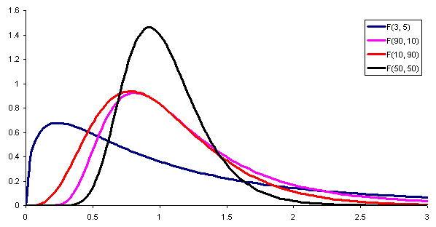
The F-Distribution
F(p-q, n-p-1)
Notes:
Suppose there is a model with k parameters compared to a model with k+1 parameters:
We would like to know which model is better:
t-test on beta_k+1.
F test

Slide 68
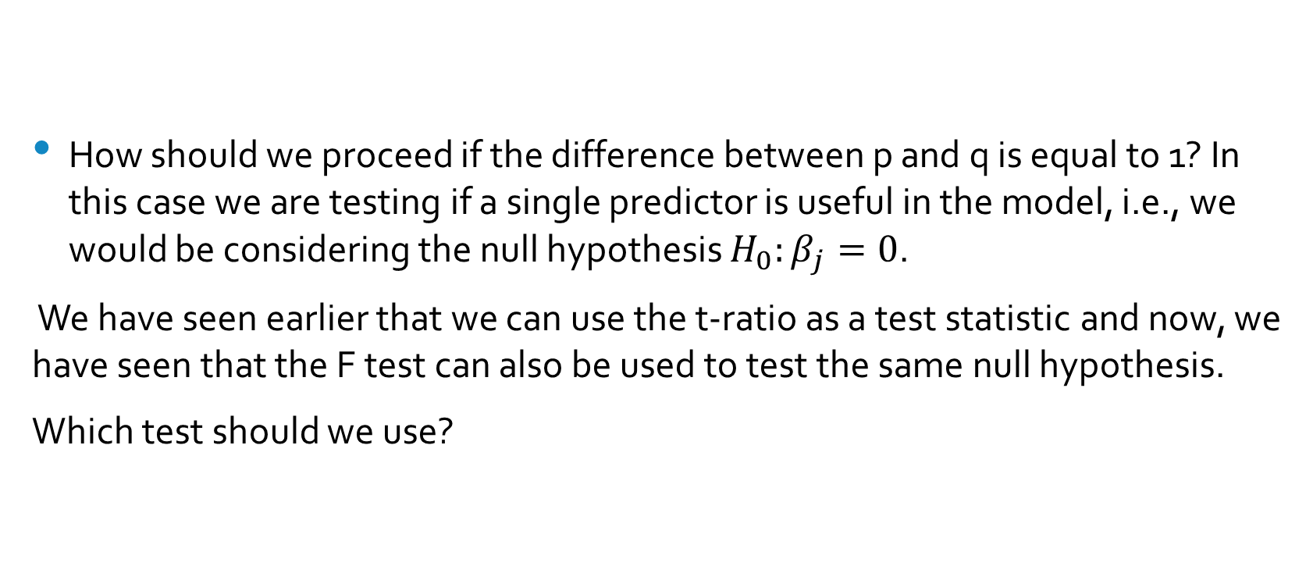
The relationship between the F and t distributions
How should we proceed if the difference between p and q is equal to 1? In this case we are testing if a single predictor is useful in the model, i.e., we would be considering the null hypothesis $H_{0}:β_{j}=0$.
We have seen earlier that we can use the t-ratio as a test statistic and now, we have seen that the F test can also be used to test the same null hypothesis.
Which test should we use?

Slide 69
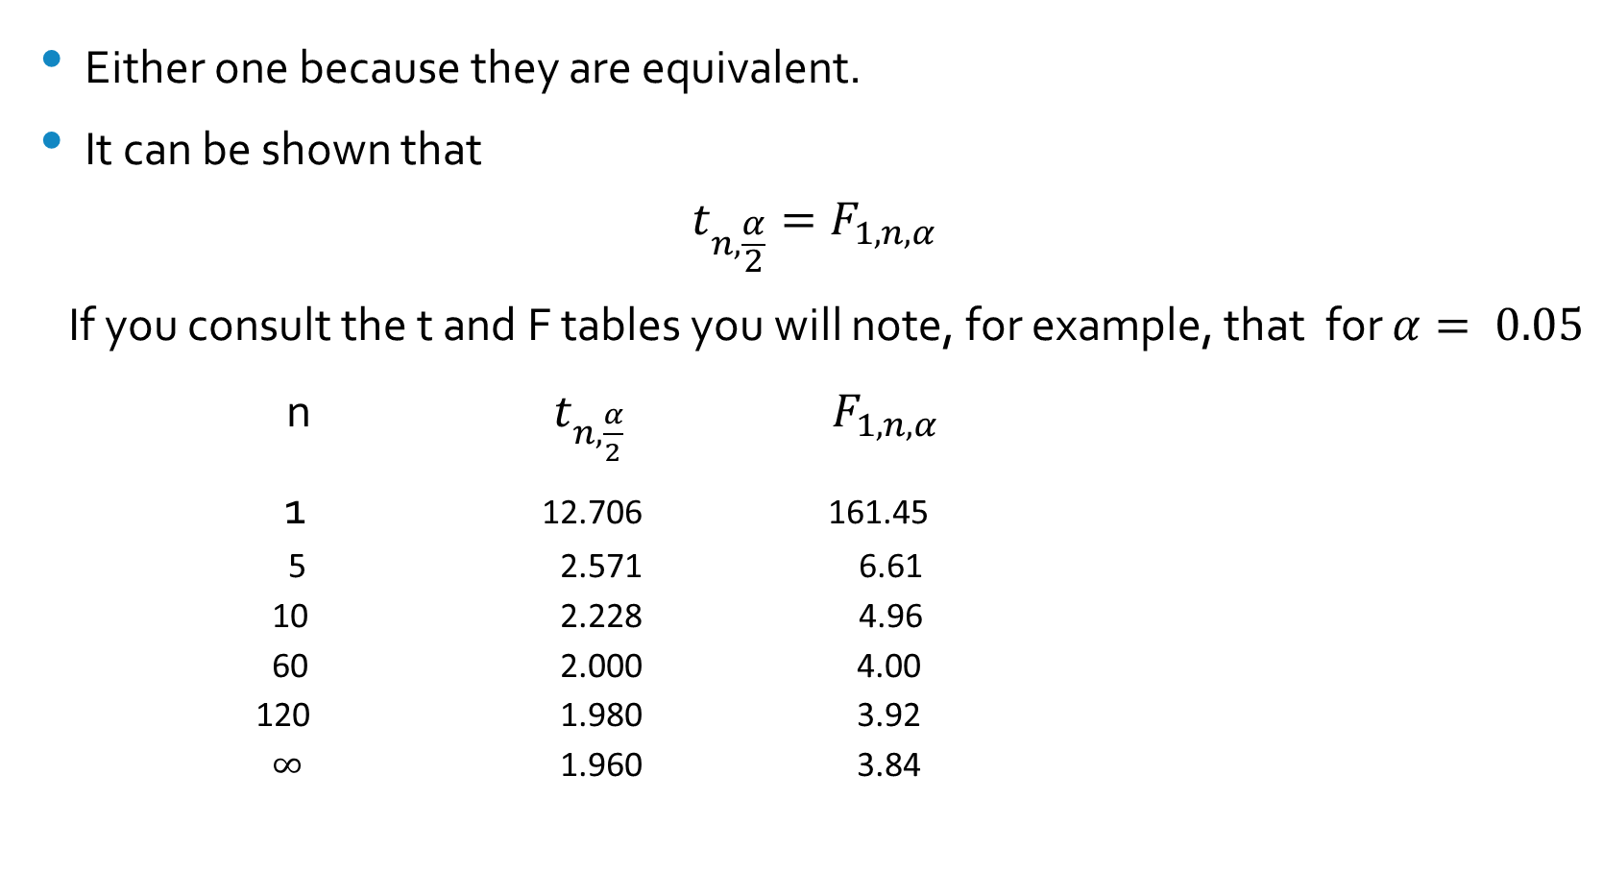
The relationship between the F and t distributions
Either one because they are equivalent.
It can be shown that
$$t_{n,\frac{α}{2}}=F_{1,n,α}$$
If you consult the t and F tables you will note, for example, that for $α= 0.05$
n $t_{n,\frac{α}{2}}$ $F_{1,n,α}$
1 12.706 161.45
5 2.571 6.61
10 2.228 4.96
60 2.000 4.00
120 1.980 3.92
$∞$ 1.960 3.84

Slide 70
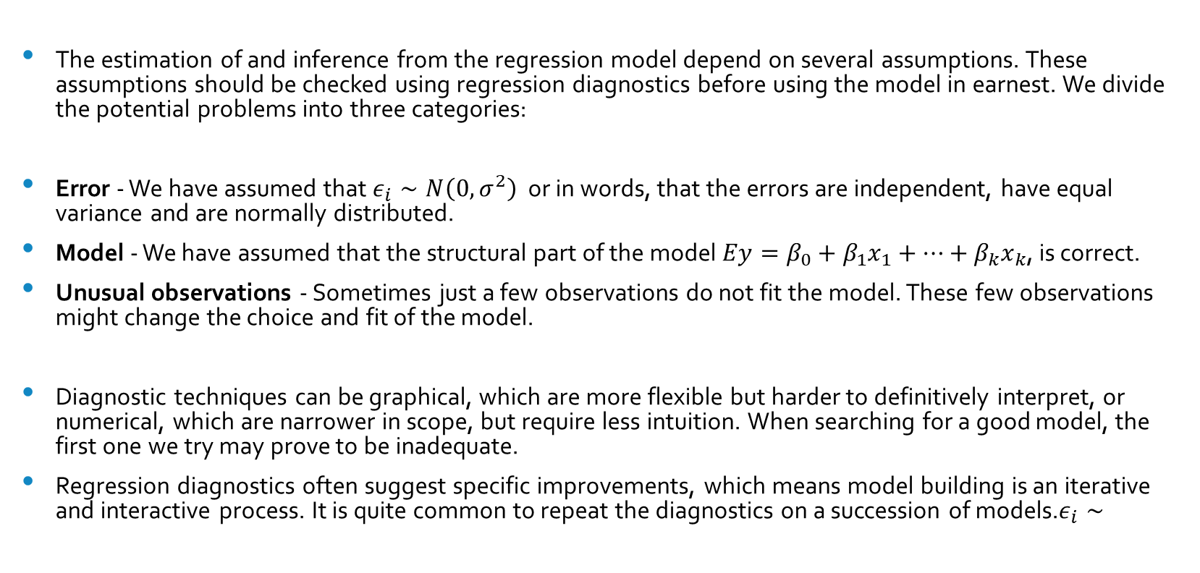
Diagnostics
The estimation of and inference from the regression model depend on several assumptions. These assumptions should be checked using regression diagnostics before using the model in earnest. We divide the potential problems into three categories:
Error - We have assumed that $ε_{i}∼N\left(0,σ^{2}\right)$ or in words, that the errors are independent, have equal variance and are normally distributed.
Model - We have assumed that the structural part of the model $Ey=β_{0}+β_{1}x_{1}+…+β_{k}x_{k}$, is correct.
Unusual observations - Sometimes just a few observations do not fit the model. These few observations might change the choice and fit of the model.
Diagnostic techniques can be graphical, which are more flexible but harder to definitively interpret, or numerical, which are narrower in scope, but require less intuition. When searching for a good model, the first one we try may prove to be inadequate.
Regression diagnostics often suggest specific improvements, which means model building is an iterative and interactive process. It is quite common to repeat the diagnostics on a succession of models.$ε_{i}∼$

Slide 71
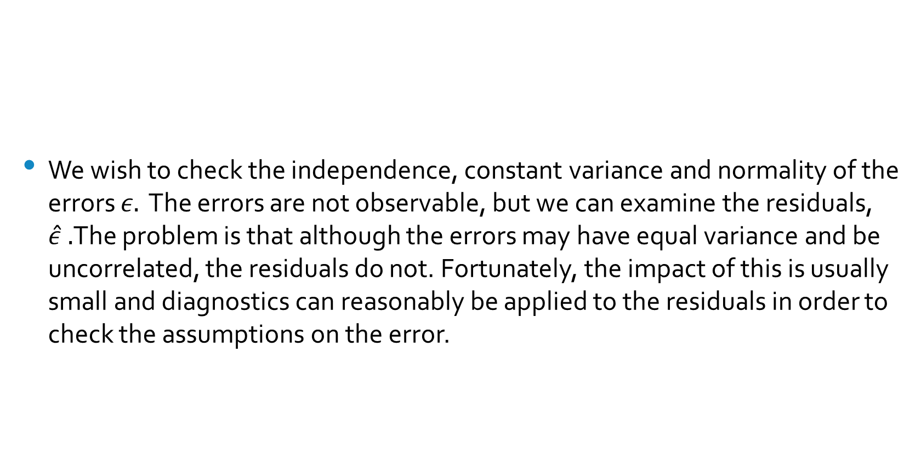
Checking Error Assumptions
We wish to check the independence, constant variance and normality of the errors $ε.$ The errors are not observable, but we can examine the residuals, $\hat{ε} .$The problem is that although the errors may have equal variance and be uncorrelated, the residuals do not. Fortunately, the impact of this is usually small and diagnostics can reasonably be applied to the residuals in order to check the assumptions on the error.

Slide 72
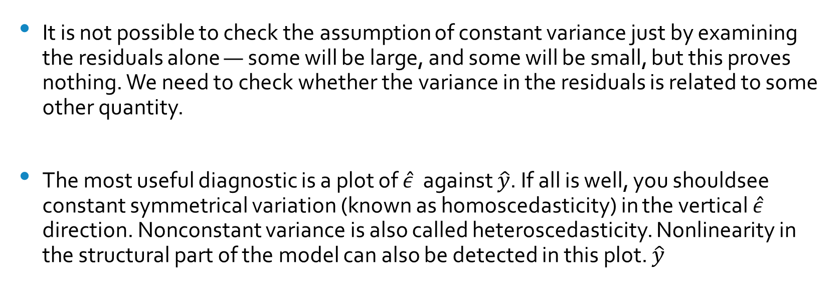
Constant Variance
It is not possible to check the assumption of constant variance just by examining the residuals alone — some will be large, and some will be small, but this proves nothing. We need to check whether the variance in the residuals is related to some other quantity.
The most useful diagnostic is a plot of $\hat{ε}$ against $\hat{y}$. If all is well, you shouldsee constant symmetrical variation (known as homoscedasticity) in the vertical $\hat{ε}$ direction. Nonconstant variance is also called heteroscedasticity. Nonlinearity in the structural part of the model can also be detected in this plot. $\hat{y}$

Slide 73
Examples
In the figure below, three distinct cases are illustrated Residuals vs. fitted plots — the first suggests no change to the current model while the second shows nonconstant variance and the third indicates some nonlinearity, which should prompt some change in the structural form of the model.
Be skeptical about using least square model
Including a quadratic term in the model

Slide 74
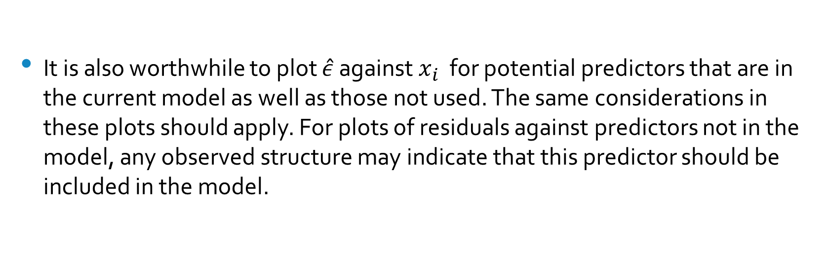
Other Plots
It is also worthwhile to plot $\hat{ε}$ against $x_{i}$ for potential predictors that are in the current model as well as those not used. The same considerations in these plots should apply. For plots of residuals against predictors not in the model, any observed structure may indicate that this predictor should be included in the model.

Slide 75
Normality and Correlated Errors
The tests and confidence intervals we use are based on the assumption of normal errors. The residuals can be assessed for normality using a Q–Q plot. This compares the residuals to “ideal” normal observations.
Plot a qq-plot (residuals against a normal distribution) to check if residuals are normally distributed.
(value on the right higher than expected, value on the left lower than expected are indications of heavy tails.)
It is difficult to check for correlated errors in general because there are just too many possible patterns of correlation that may occur. We do not have enough information to make any reasonable check. But some types of data have a structure which suggests where to look for problems. Data collected over time may have some correlation in successive errors. Spatial data may have correlation in the errors of nearby measurements. Data collected in blocks may show correlated errors within those blocks.

Slide 76
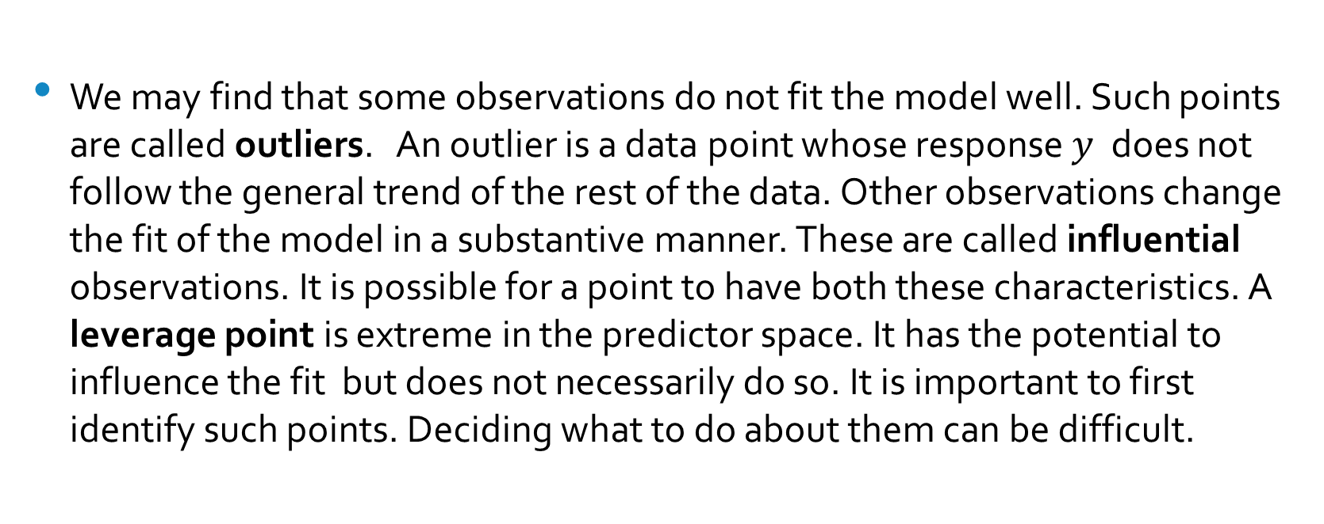
Unusual Observations
We may find that some observations do not fit the model well. Such points are called outliers. An outlier is a data point whose response $y$ does not follow the general trend of the rest of the data. Other observations change the fit of the model in a substantive manner. These are called influential observations. It is possible for a point to have both these characteristics. A leverage point is extreme in the predictor space. It has the potential to influence the fit but does not necessarily do so. It is important to first identify such points. Deciding what to do about them can be difficult.

Slide 77
Unusual Observations (2)
Outlier but not leverage point,
since it does not have an extreme x value
The point changes the slope quite a bit
The point is an influential leverage point
Not the outlier, fits the model very well
Not a leverage point
Dashed line is the adjusted line

Slide 78
High Leverage Points
A data point has high leverage if it has "extreme" predictor x values. With a single predictor, an extreme x value is simply one that is particularly high or low. With multiple predictors, extreme x values may be particularly high or low for one or more predictors or may be "unusual" combinations of predictor values (e.g., with two predictors that are positively correlated, an unusual combination of predictor values might be a high value of one predictor paired with a low value of the other predictor).

Slide 79
Influential Points
A data point is influential if it unduly influences any part of a regression analysis, such as the predicted responses, the estimated slope coefficients, or the hypothesis test results. Outliers and high leverage data points have the potential to be influential, but we generally have to investigate further to determine whether or not they are actually influential.

Slide 80
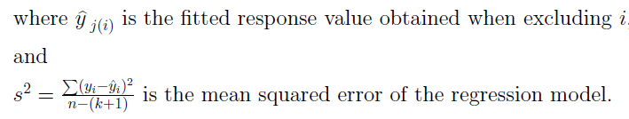
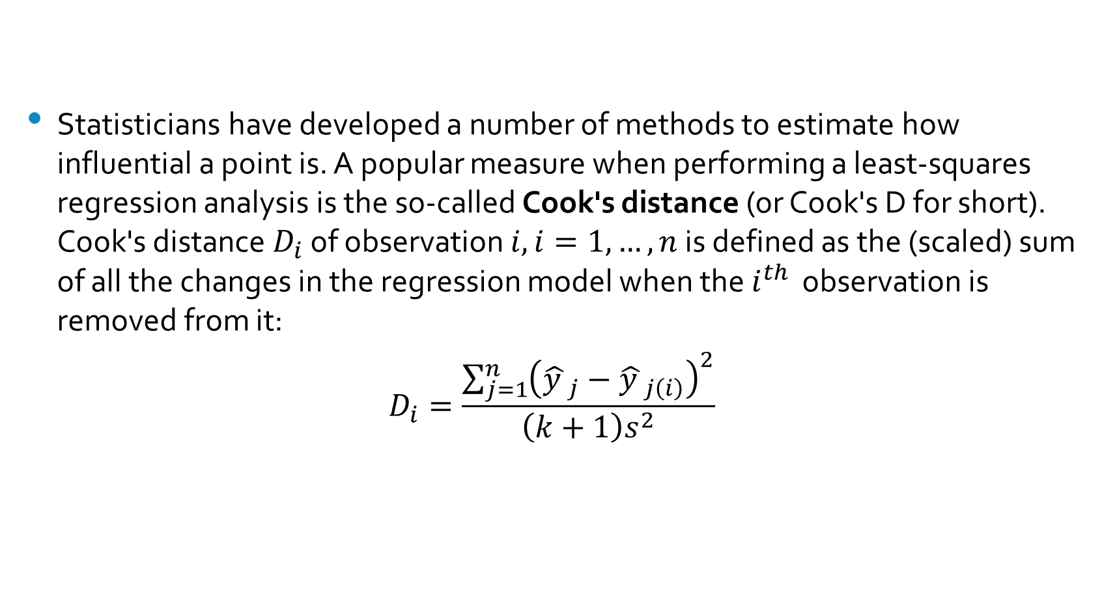
Cook’s Distance
Statisticians have developed a number of methods to estimate how influential a point is. A popular measure when performing a least-squares regression analysis is the so-called Cook's distance (or Cook's D for short). Cook's distance $D_{i}$ of observation $i, i=1,…,n$ is defined as the (scaled) sum of all the changes in the regression model when the $i^{th}$ observation is removed from it:
$$D_{i}=\frac{\sum_{j=1}^{n}{{\left({\hat{y }}_{j}−{\hat{y }}_{j\left(i\right)}\right)}^{2}}}{\left(k+1\right)s^{2}}$$

Slide 81
Summary
Some assumptions a more important than others because some violations are more serious in that they can lead to very misleading conclusions. We can order these assumptions according to their importance:
1. The systematic form of the model. If you get this seriously wrong, then predictions will be inaccurate and any explanation of the relationship between the variables may be biased in misleading ways.
2. Dependence of errors. The presence of strong dependence means that there is less information in the data than the sample size may suggest. Furthermore, there is a risk that the analyst will mistakenly introduce systematic components to the model in an attempt to deal with an unsuspected dependence in the errors. Unfortunately, it is difficult to detect dependence in the errors using regression diagnostics except in special situations such as temporal data. For other types of data, the analyst will need to rely on less testable assumptions about independence based on contextual knowledge.
3. Nonconstant variance. A failure to address this violation of the linear model assumptions may result in inaccurate inferences. In particular, prediction uncertainty may not be properly quantified. Even so, excepting serious violations, the adequacy of the inference may not be seriously compromised.
4. Normality. This is the least important assumption. For large datasets, the inference will be quite robust to a lack of normality as the central limit theorem will mean that the approximations will tend to be adequate. Unless the sample size is quite small or the errors very strongly abnormal, this assumption is not crucial to success.
Although it is not part of regression diagnostics, it is worthwhile also mentioning that an even more important assumption is that the data at hand are relevant to the question of interest. This requires some qualitative judgement and is not checkable by plots or tests.

Slide 82
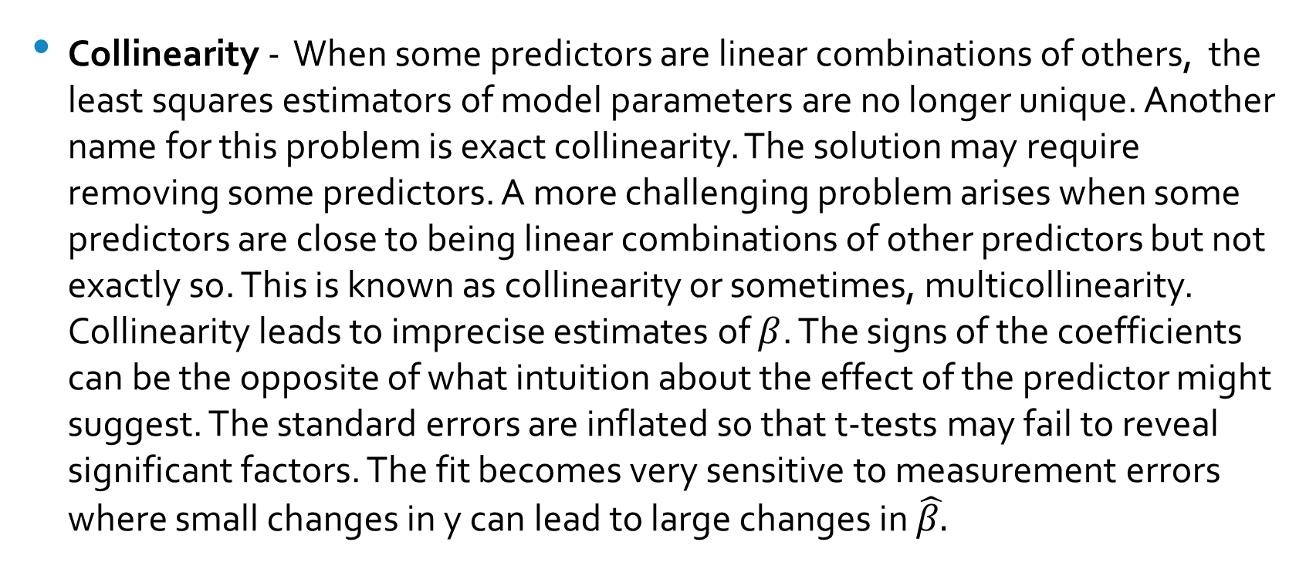
Problems with the Predictors
Collinearity - When some predictors are linear combinations of others, the least squares estimators of model parameters are no longer unique. Another name for this problem is exact collinearity. The solution may require removing some predictors. A more challenging problem arises when some predictors are close to being linear combinations of other predictors but not exactly so. This is known as collinearity or sometimes, multicollinearity. Collinearity leads to imprecise estimates of $β$. The signs of the coefficients can be the opposite of what intuition about the effect of the predictor might suggest. The standard errors are inflated so that t-tests may fail to reveal significant factors. The fit becomes very sensitive to measurement errors where small changes in y can lead to large changes in $\hat{β.}$

Slide 83
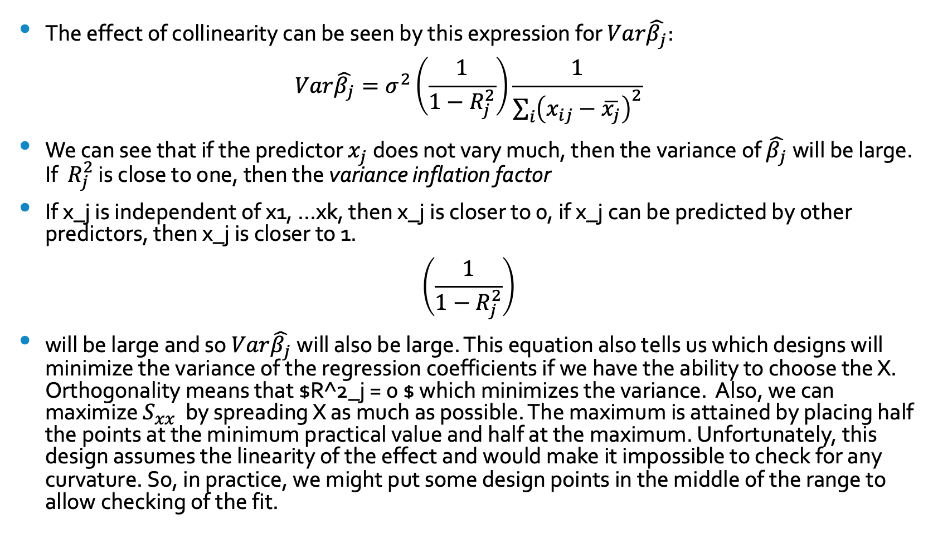
The Impact of Collinearity
The effect of collinearity can be seen by this expression for $Var\hat{β_{j}}$:
$$Var\hat{β_{j}}=σ^{2}\left(\frac{1}{1−R_{j}^{2}}\right)\frac{1}{\sum_{i}{{\left(x_{ij}−\overline{x_{j}}\right)}^{2}}}$$
We can see that if the predictor $x_{j}$does not vary much, then the variance of $\hat{β_{j}}$will be large. If $R_{j}^{2}$ is close to one, then the variance inflation factor
If x_j is independent of x1, …xk, then x_j is closer to 0, if x_j can be predicted by other predictors, then x_j is closer to 1.
$$\left(\frac{1}{1−R_{j}^{2}}\right)$$
will be large and so $Var\hat{β_{j}}$will also be large. This equation also tells us which designs will minimize the variance of the regression coefficients if we have the ability to choose the X. Orthogonality means that $R^2_j = 0 $ which minimizes the variance. Also, we can maximize $S_{xx}$ by spreading X as much as possible. The maximum is attained by placing half the points at the minimum practical value and half at the maximum. Unfortunately, this design assumes the linearity of the effect and would make it impossible to check for any curvature. So, in practice, we might put some design points in the middle of the range to allow checking of the fit.

Slide 84
y
X1, x2…,x100
estimates standard error t-value
Intercept
Beta1_hat
Beta2_hat
…
Beta100_hat
Select alpha_critical (0.1/ 0.15),
Backward elimination: eliminate variables according to t_value. Variables with the largest p-value will be removed first
until p_value is below alpha_critical.
/forward selection : start with no variables in the model, and then for all predictors not in the model, we check their
p-values if they are added to the model. We choose the one with lowest p-value less than alpha_critical. We continue
Until no new predictors can be added. add more variables until you would have a p-value above alpha_critical
/stepwise regression: mixing the two. This addresses the situation where variables are added or removed early in
the process, and we want to change our mind about them later. At each stage a variable may be added or removed
and there are several variations on exactly how this is done.

Slide 85
Lemaire is not trying to explain the additional 4.5 years, which should be explained by biological differences.
Lemaire is trying to explain the variability in the additional 4.5 years that women outlive men on average.
Men’s consumption of alcohol explains the Soviet union dummy (coefficient = 4.922)
Analysis:
This regression model explains R2 = 0.61 of the variability
It is a parsimonious model consisting of only k = 4 of the original 45 variables
The number of persons per physician was also correlated with other variables that capture a country’s
degrees of economic modernization, such as urbanization, number of cars, and percentage working in agriculture
4. Fertility, the number of births per woman, was highly correlated with education variables in the study, including
Female illiteracy and female school enrollment
5. The percentage of Hindus and Buddhists is a social, cultural, and religious variable
6. The Soviet Union dummy is a geographic variable – it characterizes Eastern European countries that formerly
belonged to the Soviet Union
7. Because of the high degree of collinearity among the 45 candidate variables, other analysts could easily pick
an alternative set of variables
Nonetheless, Lemaire’s important point was that this simple model explains roughly 61 % of the variability from only
behavioral variables, unrelated to biological sex differences.

Slide 86
Dummy variable:
Two regression lines (one for soviet union, one for nonsoviet union) to inflate R^2
Critique:
Analysis: The model selection process is not explained
Soviet Union dummy is an ex-post addition
R-squared is the only measure of performance discussed
No analysis of residuals is described
No alternative models are discussed
The problem of aggregation of data
Hispanics immigrate to wealthier states with more job opportunities.
The influx of Hispanics into the state does not increase the state’s average household income.

Slide 87
Final Exam Topics
Simple Linear Regression
a. The Simple Linear Model
b. Least Squares Parameter Estimation
c. Model Assumptions
d. Correlation Coefficient
e. Coefficient of Determination
f. Estimation and Prediction
g. t-Test for the slope of the Regression Line
Multiple Linear Regression
a. Parameter Estimation
b. Model Assumptions
c. R-Squared and Adjusted R-Squared
d. Evaluating the Utility of the Model
e. Comparing Models – The F-Test
f. Diagnostics
g. Analysis of Residuals

